Slide 1
Azure Cosmos DB Technical Deep Dive
Sashank Pappu
Azure Data & AI Specialist

Slide 2
Azure Cosmos DB
A FULLY-MANAGED GLOBALLY DISTRIBUTED DATABASE SERVICE BUILT TO GUARANTEE
EXTREMELY LOW LATENCY AND MASSIVE SCALE FOR MODERN APPS

Slide 3


Azure Cosmos DB
A globally distributed, massively scalable, multi-model database service
Elastic scale out
of storage & throughput
Guaranteed low latency at the 99th percentile
Five well-defined consistency models
Turnkey global distribution
Comprehensive SLAs
Notes:
Azure Cosmos DB offers the first globally distributed, multi-model database service for building planet scale apps. It’s been powering Microsoft’s internet-scale services for years, and now it’s ready to launch yours.
Only Azure Cosmos DB makes global distribution turn-key.
You can add Azure locations to your database anywhere across the world, at any time, with a single click. Cosmos DB will seamlessly replicate your data and make it highly available.
Cosmos DB allows you to scale throughput and storage elastically, and globally! You only pay for the throughput and storage you need – anywhere in the world, at any time.

Slide 4
Azure Cosmos DB
A globally distributed, massively scalable, multi-model database service
Column-family
Document
Key-value
Graph
Elastic scale out
of storage & throughput
Guaranteed low latency at the 99th percentile
Five well-defined consistency models
Turnkey global distribution
Comprehensive SLAs
Notes:
Azure Cosmos DB offers the first globally distributed, multi-model database service for building planet scale apps. It’s been powering Microsoft’s internet-scale services for years, and now it’s ready to launch yours.
Only Azure Cosmos DB makes global distribution turn-key.
You can add Azure locations to your database anywhere across the world, at any time, with a single click. Cosmos DB will seamlessly replicate your data and make it highly available.
Cosmos DB allows you to scale throughput and storage elastically, and globally! You only pay for the throughput and storage you need – anywhere in the world, at any time.

Slide 5



Azure Cosmos DB
A globally distributed, massively scalable, multi-model database service
Cosmos DB’s API for
MongoDB
Table API
Column-family
Document
Key-value
Graph
Elastic scale out
of storage & throughput
Guaranteed low latency at the 99th percentile
Five well-defined consistency models
Turnkey global distribution
Comprehensive SLAs
Notes:
Azure Cosmos DB offers the first globally distributed, multi-model database service for building planet scale apps. It’s been powering Microsoft’s internet-scale services for years, and now it’s ready to launch yours.
Only Azure Cosmos DB makes global distribution turn-key.
You can add Azure locations to your database anywhere across the world, at any time, with a single click. Cosmos DB will seamlessly replicate your data and make it highly available.
Cosmos DB allows you to scale throughput and storage elastically, and globally! You only pay for the throughput and storage you need – anywhere in the world, at any time.

Slide 6

Overview & Value Proposition

Slide 7
Elastically Scale Storage and Throughput
Independently and elastically scale storage and throughput across regions – even during unpredictable traffic bursts – with a database that adapts to your app’s needs.
Elastically scale throughput from 10 to 100s of millions of requests/sec across multiple regions
Support for requests/sec for different workloads
Pay only for the throughput and storage you need
Notes:
Elastic Scale out -> Tunable Consistency
Small storage – large throughput (e.g. notification broadcast/poll)
Large storage – small throughput (e.g. classic data/log store)

Slide 8
Guaranteed Low Latency
Provide users around the world with fast access to data
Serve <10 ms read and <10 ms write requests at the 99th percentile from the region nearest to users, while delivering data globally.
Notes:
Single digit latency -> SLA

Slide 9
Turnkey Global Distribution
Put your data where your users are in minutes
Automatically replicate all your data around the world, and across more regions than Amazon and Google combined.
Available in all Azure regions
Manual and automatic failover
Automatic & synchronous multi-region replication
Configure multiple write regions to further reduce latency and increase availability
Notes:
Elastic Scale out -> Tunable Consistency
Small storage – large throughput (e.g. notification broadcast/poll)
Large storage – small throughput (e.g. classic data/log store)

Slide 10
Five Well-Defined Consistency Models
Choose the best consistency model for your app
Offers five consistency models
Provides control over performance-consistency tradeoffs, backed by comprehensive SLAs.
An intuitive programming model offering low latency and high availability for your planet-scale app.
Strong
Bounded-stateless
Session
Consistent prefix
Eventual
Notes:
Tunable Consistency -> Single digit latency
Instead of forcing you to choose between eventual and strong consistency, Cosmos DB gives you many additional useful options.
Bounded Staleness - Consistent Prefix. Reads lag behind writes by k prefixes or t interval
Session - Consistent Prefix. Monotonic reads, monotonic writes, read-your-writes, write-follows-reads
Consistent Prefix - Updates returned are some prefix of all the updates, with no gaps

Slide 11


Multiple Data Models and API’s
Use the model that fits your requirements, and the apis, tools, and frameworks you prefer
Cosmos DB offers a multitude of APIs to access and query data including, SQL, various popular OSS APIs, and native support for NoSQL workloads.
Use key-value, columnar, graph, and document data
Data is automatically indexed, with no schema or secondary indexes required
Blazing fast queries with no lag
MongoDB
Table API
SQL
Column-family
Document
Key-value
Graph
Notes:
Multi – Model -> Elastic Scale out
No need to convert you data to meet any particular model

Slide 12
Handle any Data with no Schema or Indexing Required
Azure Cosmos DB’s schema-less service automatically indexes all your data, regardless of the data model, to delivery blazing fast queries.
Automatic index management
Synchronous auto-indexing
Freedom from schema + index management
Works across every data model
Ingest and serve data back out in milliseconds
GEEK
Item | Color | Microwave safe | Liquid capacity | CPU | Memory | Storage
Geek mug | Graphite | Yes | 16ox | ??? | ??? | ???
Coffee Bean mug | Tan | No | 12oz | ??? | ??? | ???
Surface book | Gray | ??? | ??? | 3.4 GHz Intel Skylake Core i7-6600U | 16GB | 1 TB SSD
Notes:
Automatic and synchronous indexing of all ingested content - hash, range, geo-spatial, and columnar
No schemas or secondary indices ever needed
Resource governed, write optimized database engine with latch free and log structured techniques
Online and in-situ index transformations
While the database is fully schema-agnostic, schema-extraction is built in
Customers can get Avro schemas from the database

Slide 13
Comprehensive SLA’s
Run your app on world-class infrastructure.
Azure Cosmos DB is the only service with financially-backed SLAs for millisecond latency at the 99th percentile, 99.999% HA and guaranteed throughput and consistency
Latency
HA
Throughput
Consistency
<10 ms
99.999%
Guaranteed
Guaranteed
99th percentile
Notes:
HA 99.999% for multi-region read; 99.99% for single region deployments

Slide 14
Trust your Data to Industry-Leading Security & Compliance
Azure is the world’s most trusted cloud, with more certifications than any other cloud provider.
Enterprise grade security
Encryption at Rest and Transit
Encryption is enabled automatically by default
Comprehensive Azure compliance certification
Notes:
Encryption at Rest
Always encrypted at rest and in motion
Data, index, backups, and attachments encrypted
Encryption is enabled automatically by default
No impact on performance, throughput or availability
Transparent to your application
Comprehensive Azure compliance certification
ISO 27001, ISO 27018, EUMC, HIPAA, PCI
SOC1 and SOC2 (Audit complete, Certification in Q2 2017)
FedRAMP, IRS 1075, UK Official (IL2) (Q2 2017)
HITRUST (H2 2017)
Updated and added to monthly

Slide 15
Resource Model

Slide 16
Resource Model
Account
Database
Database
Database
Database
Database
Container
Database
Database
Item
Notes:
A tenant of the Cosmos DB service starts by provisioning a database account. A database account manages one or more databases. A Cosmos DB database manages users, permissions and containers. A Cosmos DB resource container is a schema-agnostic container of arbitrary user-generated JSON items and JavaScript based stored procedures, triggers and user-defined-functions (UDFs). Entities under the tenant’s database account – databases, users, permissions, containers etc. are referred to as resources.
Each resource is uniquely identified by a stable and logical URI and represented as a JSON document. The overall resource model of an application using Cosmos DB is a hierarchical overlay of the resources rooted under the database account, and can be navigated using hyperlinks. Except for the item resource, which is used to represent arbitrary user defined JSON content, all other resources have a system-defined schema.
Container and item resources are further projected as reified resource types for a specific type of API interface. For example, while using document-oriented APIs, container and item resources are projected as collection (container) and document (item) resources, respectively; likewise, for graph-oriented API access, the underlying container and item resources are projected as graph (container), node (item) and edge (item) resources respectively; while accessing using a key-value API table (container) and item/row (item) are projected.

Slide 17
Account URI and Credentials
Account
********.azure.com
Database
Database
Database
IGeAvVUp …
Database
Database
Container
Database
Database
Item

Slide 18
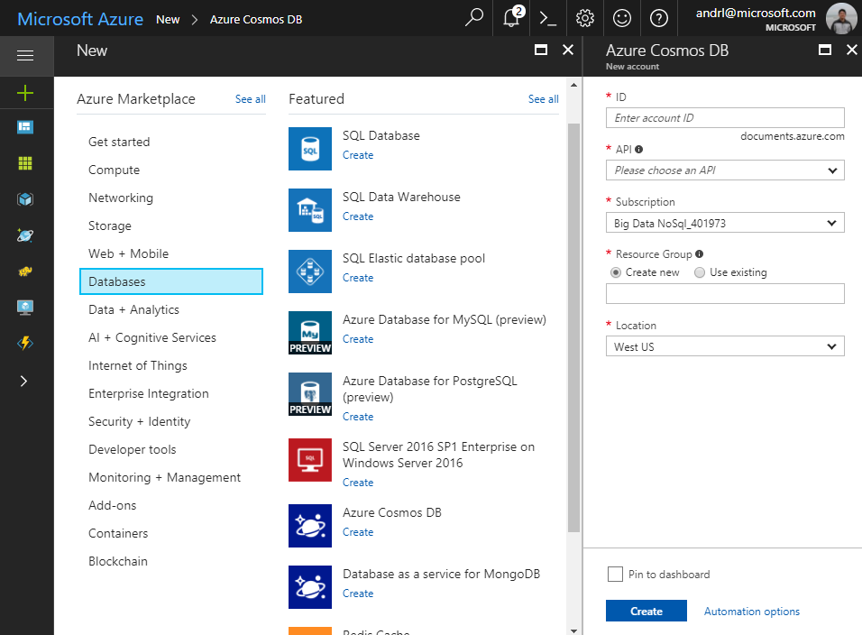
Creating Account
Account
Database
Database
Database
Database
Database
Container
Database
Database
Item

Slide 19
Database Representations
Account
Database has 1 or more containers
Database
Database
Database
Database
Database
Container
Database
Database
Item

Slide 20
Container Representations
Account
Container – can be a collection, graph or table
Database
Database
Database
Database
=
Database
Container
Collection
Graph
Table
Database
Database
Item

Slide 21
Creating Collections – SQL API
Account
Items – can be document, vertices/edges, or row
Database
Database
Database
Database
Database
Container
Collection
Graph
Table
Database
Database
Item
Document Vertices/Edges Row

Slide 22
Container-Level Resources
Account
Associate stored procedures, triggers, UDF with container
Database
Database
Database
Database
Database
Container
Database
Database
Sproc
Trigger
UDF
Item

Slide 23
System Internals

Slide 24
System design (logical)
Tenants
Follower
Follower
Collections
Graphs
Leader
Forwarder
Tables
Replica set
To a remote resource partition(s)
Container
Container
Container
Resource Partition
A consistent, highly available, and resource governed coordination primitive
Consists of a replica set with each replica hosting an instance of database engine
Uniquely belongs to a tenant
Owns a set of keys
Containers
…
Resource Partitions

Slide 25
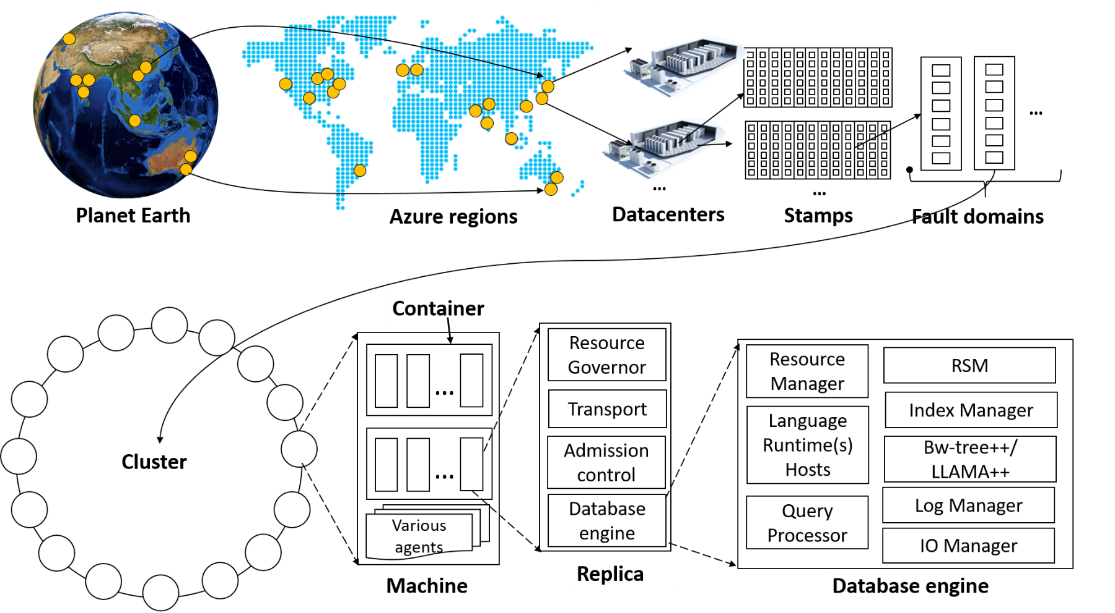
System topology (behind the scenes)
Notes:
The Cosmos DB service is deployed worldwide across all Azure regions including the sovereign and government clouds. We deploy and manage the Cosmos DB service on stamps of machines, each with dedicated local SSDs. The Cosmos DB service is layered on top of Azure Service Fabric, which is a foundational distributed systems infrastructure of Azure. Cosmos DB uses Service Fabric for naming, routing, cluster and container management, coordination of rolling upgrades, failure detection, leader election (within a resource partition) and load balancing capabilities. Cosmos DB is deployed across one or more Service Fabric clusters, each potentially running multiple generations of hardware and of varying number of machines (currently, between 60-800 machines).
Machines within a cluster typically are spread across 10-20 fault domains. The resource partitions is a logical concept. Physically, a resource partition is implemented in terms of a group of replicas, called replica-sets. Each machine hosts replicas corresponding to various resource partitions within a fixed set of processes. Replicas corresponding to the resource partitions are placed and load balanced across these machines. Each replica hosts an instance of Cosmos DB’s schema-agnostic database engine, which manages the resources as well as the associated indexes. The Cosmos DB database engine, in-turn, consists of components including implementation of several coordination primitives, the JavaScript language runtime, the query processor, the storage and indexing subsystems responsible for transactional storage and indexing of data, respectively. To provide durability and high availability, the database engine persists its index on SSDs and replicates it among the database engine instances within the replica-set(s) respectively. While the index is always persisted on local SSDs, the log is persisted either locally, on another machine within the cluster, or remotely across cluster or a datacenter within a region. The proximity of the index and log is configurable based on the price and latency SLA. The ability to dynamically configure the proximity between the database engine (compute) and log (storage) at the granularity of replicas of a resource partition is crucial for allowing tenants to dynamically select various service tiers.

Slide 26
Request Units & Billing

Slide 27
Billing Model
2 components: Storage + Throughput
You are billed on consumed storage and provisioned throughput
Collections in a database can share throughput
Unit | Price (for most Azure regions)
SSD Storage (per GB) | $0.25 per month
Provisioned Throughput (single region writes) | $0.008/hour per 100 RU/s
Provisioned Throughput (multi-region writes) | $0.016/hour per 100 multi-master RU/s
* pricing may vary by region; for up-to-date pricing, see: https://azure.microsoft.com/pricing/details/cosmos-db/

Slide 28
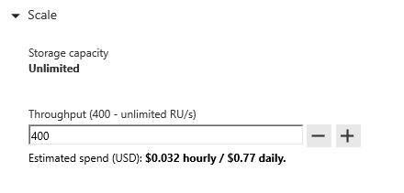
Request Units
Request Units (RUs) is a rate-based currency – e.g. 1000 RU/second
Abstracts physical resources for performing requests
% Memory
% CPU
% IOPS

Slide 29
Request Units
Each request consumes # of RU
Approx. 1 RU = 1 read of 1 KB document
Approx. 5 RU = 1 write of a 1KB document
Query: Depends on query & documents involved
GET
=
POST
=
PUT
=
Query
=
…
Notes:
The number of RU’s each operation consumes depends on many factors which include:
Document size
Number of indexed fields
Type of indexes
Consistency model choice
Not all queries will consume equal numbers of RU’s. Some operations are more computationally complex or require scans through more documents and therefore use more RU’s.

Slide 30
Request Units- Provisioned throughput
Provisioned in terms of RU/sec – e.g. 1000 RU/s
Billed for highest RU/s in 1 hour
Easy to increase and decrease on demand
Rate limiting based on amount of throughput provisioned
Background processes like TTL expiration, index transformations scheduled when quiescent
Storage: 40RU per 1GB of data
Rate limiting – SDK retry
Max RU/sec
Incoming Requests
No rate limiting
Min RU/sec
No rate limiting, process background operations
Notes:
We want to avoid throttling (rate limiting)

Slide 31
Scaling RU/s using .NET SDK
Notes:
Scaling Up RU/s for high write ingest
You can show the power of elastically scalable throughput using this demo:
https://github.com/Azure/azure-cosmos-dotnet-v2/tree/master/samples/documentdb-benchmark
Important: Make sure you run the benchmarking tool on an Azure VM in the same region as your Cosmos DB account.

Slide 32
Estimating required RU/s
Operation Type | # Requests per sec | # RU's per Request | RU's Needed
Write Single Document | 10,000 | 10 | 100,000
Top Query #1 | 700 | 100 | 70,000
Top Query #2 | 200 | 100 | 20,000
Top Query #3 | 100 | 100 | 10,000
Total RU/s |  |  | 200,000 RU/s
Guidance:
Identify query & access patterns – e.g. top 5 queries, or # reads/writes per second
Use ‘Request Charge’ property from SDK + sample document to see # RU / operation
POC / Load test -> Scale up, and scale down
Scale 5-10x above the average number of RU’s needed per second

Slide 33
Database Level Throughput
You can provision throughput at the database level instead of individually for each container
Throughput is shared among each designated container within the database
You can provision dedicated throughput for some containers
Notes:
We want to avoid throttling (rate limiting)

Slide 34
Database vs Container Level Throughput
In general, container level throughput is a good choice. This leads to predictable performance since each container is guaranteed its provisioned RU’s
Choosing Database Level Throughput can also be a good option if:
You are migrating many containers in a lift and shift migration (from Table Storage, MongoDB, or Cassandra) and does not know how much throughput to set for each one
You have containers that are timeshared
Multitenant applications where each user is represented by a separate container
Notes:
We want to avoid throttling (rate limiting)

Slide 35
Pricing Example – Do this exercise to ballpark cost + RU/s required
Storage Cost
Avg Record Size (KB) | 1
Number of Records | 100,000,000
Total Storage (GB) | 100
Monthly Cost per GB | $0.25
Expected Monthly Cost for Storage | $25.00
Throughput Cost
Operation Type | Number of Requests per sec | Avg RU's per Request | RU's Needed
Create | 100 | 5 | 500
Read | 400 | 1 | 400
Total RU/sec | 900
Hourly Cost per 100 RU/sec | $0.008
Monthly Cost per 100 RU/sec | $6.00
Expected Monthly Cost for Throughput | $54.00
Total Monthly Cost
[Total Monthly Cost] = [Monthly Cost for Storage] + [Monthly Cost for Throughput]
= $25 + $54
= $79 per month
* pricing may vary by region; for up-to-date pricing, see: https://azure.microsoft.com/pricing/details/cosmos-db/

Slide 36
Cosmos DB reserved Capacity can provide up to 65% savings
Save up to 65% with Azure Cosmos DB reserved capacity pricing
+ Up to 65% savings
Customer cost
Best value for the price
Best elasticity for the price
Saturation of provisioned capacity via sub-core multiplexing
Deep integration w/ Azure Networking
No need to segment
into read and write workloads –
w/ unified and normalized throughput currency - RUs
Total Time To Live (TTL) is free
Enterprise-ready (security, compliance, encryption) at no additional cost

Slide 37
Azure Cosmos DB Reserved Capacity
Marginal Discounts
 | 1 Year |  | 3 Year
Throughput | Single Region Writes | Multiple Regions Writes | Single Region Writes | Multiple Regions Writes
First 100K RU/s | 20% | 25% | 30% | 35%
Next 400K RU/s | 25% | 30% | 35% | 40%
Next 2.5M RU/s | 30% | 35% | 45% | 50%
Over 3M RU/s | 45% | 50% | 60% | 65%
Azure Cosmos DB Reserved Capacity helps you save money by pre-paying for one-year or three-years of Cosmos DB capacity allowing you to get a discount on the Cosmos DB resources, e.g., databases, containers (tables/collections/graphs) you use.
Azure Cosmos DB Reserved Capacity can significantly reduce your Cosmos DB costs—up to 65 percent on regular prices–with one-year or three-year upfront commitment.
Reserved Capacity provides a billing discount and does not affect the runtime state of your Cosmos DB resources.
Effective Discounts
Amount | 1 Year – single region writes | 3 Year - single region writes | 1 Year - multiple region writes | 3 Year - multiple region writes
100,000 | 20.00% | 30.00% | 25.00% | 35.00%
500,000 | 24.00% | 34.00% | 29.00% | 39.00%
1,000,000 | 27.00% | 39.50% | 32.00% | 44.50%
2,000,000 | 28.50% | 42.25% | 33.50% | 47.25%
3,000,000 | 29.00% | 43.17% | 34.00% | 48.17%
5,000,000 | 35.40% | 49.90% | 40.40% | 54.90%
10,000,000 | 40.20% | 54.95% | 45.20% | 59.95%
20,000,000 | 42.60% | 57.48% | 47.60% | 62.48%
30,000,000 | 43.40% | 58.32% | 48.40% | 63.32%

Slide 38
Cosmos DB Provisioned Throughput FAQ
Is my bill dependent on how much provisioned throughput I consume?
No, your bill is based on provisioned throughput, not consumed throughput. Therefore, your bill is predictable. If you provision, say, 1000 RU’s you know you will be billed for exactly that amount.
Is it possible to scale provisioned throughput?
Yes, it is easily to scale provisioned throughput through the portal, Azure CLI, or sdk’s. You are only billed for the peak throughput that you provision during each hour.
How does Cosmos DB geo-replication affect pricing?
When you geo-replicate Cosmos DB accounts to additional regions, we have a full copy of your data (storage as well as RU’s) in each region. Therefore, you are billed for the total storage and provisioned RU’s across all regions. More information is here: https://azure.microsoft.com/en-us/pricing/details/cosmos-db/
I have a lot of collections and it’s very expensive. How can I reduce costs?
Cosmos DB gives you options to set throughput at either the database or container/collection level. You can simply provision throughput for a database and have this throughput shared among all selected collections within the database

Slide 39
Data Modeling

Slide 40
For guidance in delivering this section please view the following:
https://www.bing.com/videos/search?q=cosmos+db+data+modeling+ignite+youtube&view=detail&mid=36B6E05A0FD76BB99B7F36B6E05A0FD76BB99B7F&FORM=VIRE

Slide 41
Data Modeling
Is just as important with relational data!
There’s still a schema – just enforced at the application level
Plan upfront for best performance & costs
Feedback: “Small collections add up ->$$$”
Answer: Smart data modelling will help

Slide 42





2 Extremes
ORM
SQL
Normalize everything
NoSQL
Embed as 1 piece

Slide 43
Contoso Restaurant Menu
Menu Item
------------
ID
Item Name
Item Description
Item Category ID
Category
------------
ID
Category Name
Category Description
Relational modelling – Each menu item has a reference to a category.
{
"ID": 1,
"ItemName": "hamburger",
"ItemDescription": "cheeseburger, no cheese",
“CategoryId": 5,
"Category": "sandwiches"
"CategoryDescription": "2 pieces of bread + filling"
}
Non-relational modeling – each menu item is a self-contained document

Slide 44




Number 1 question…
“Where are my joins?”
“Where are my joins!?!?”
Naïve way: Normalize, make 2 network calls, merge client side
But! We can model our data in a way to get the same functionality of a join, without the tradeoff

Slide 45
Modeling Challenges
#1: To de-normalize, or normalize? To embed, or to reference?
#2: Put data types in same collection, or different?

Slide 46
Modeling challenge #1: To embed or reference?
Embed
{
"menuID": 1,
"menuName": "Lunch menu",
"items": [
{"ID": 1, "ItemName": "hamburger", "ItemDescription":...}
{"ID": 2, "ItemName": "cheeseburger", "ItemDescription":...}
]
}
Reference
{
"menuID": 1,
"menuName": "Lunch menu",
"items": [
{"ID": 1}
{"ID": 2}
]
}
{"ID": 1, "ItemName": “hamburger", "ItemDescription":...}
{"ID": 2, "ItemName": “cheeseburger", "ItemDescription":...}

Slide 47
When To Embed #1
{
"ID": 1,
"ItemName": "hamburger",
"ItemDescription": "cheeseburger, no cheese",
"Category": "sandwiches",
"CategoryDescription": "2 pieces of bread + filling",
"Ingredients": [
{"ItemName": "bread", "calorieCount": 100, "Qty": "2 slices"},
{"ItemName": "lettuce", "calorieCount": 10, "Qty": "1 slice"}
{"ItemName": "tomato","calorieCount": 10, "Qty": "1 slice"}
{"ItemName": "patty", "calorieCount": 700, "Qty": "1"}
}
E.g. in Recipe, ingredients are always queried with the item

Slide 48
When To Embed #2
Child data is dependent/intrinsic to a parent
{
"id": "Order1",
"customer": "Customer1",
"orderDate": "2018-09-26",
"itemsOrdered": [
{"ID": 1, "ItemName": "hamburger", "Price":9.50, "Qty": 1}
{"ID": 2, "ItemName": "cheeseburger", "Price":9.50, "Qty": 499}
]
}
Items Ordered depends on Order

Slide 49
When To Embed #3
1:1 relationship
{
"id": "1",
"name": "Alice",
"email": "alice@contoso.com",
“phone": “555-5555"
“loyaltyNumber": 13838359,
"addresses": [
{"street": "1 Contoso Way", "city": "Seattle"},
{"street": "15 Fabrikam Lane", "city": "Orlando"}
]
}
All customers have email, phone, loyalty number for 1:1 relationship

Slide 50
When To Embed #4, #5
Similar rate of updates – does the data change at the same (slower) pace? -> Minimize writes
1:few relationships
{
"id": "1",
"name": "Alice",
"email": "alice@contoso.com",
"addresses": [
{"street": "1 Contoso Way", "city": "Seattle"},
{"street": "15 Fabrikam Lane", "city": "Orlando"}
]
}
//Email, addresses don’t change too often

Slide 51
When To Embed - Summary
Data from entities is queried together
Child data is dependent on a parent
1:1 relationship
Similar rate of updates – does the data change at the same pace
1:few – the set of values is bounded
Usually embedding provides better read performance
Follow-above to minimize trade-off for write perf

Slide 52
Modeling challenge #1: To embed or reference?
Embed
{
"menuID": 1,
"menuName": "Lunch menu",
"items": [
{"ID": 1, "ItemName": "hamburger", "ItemDescription":...}
{"ID": 2, "ItemName": "cheeseburger", "ItemDescription":...}
]
}
Reference
{
"menuID": 1,
"menuName": "Lunch menu",
"items": [
{"ID": 1}
{"ID": 2}
]
}
{"ID": 1, "ItemName": “hamburger", "ItemDescription":...}
{"ID": 2, "ItemName": “cheeseburger", "ItemDescription":...}

Slide 53
When To Reference #1
1 : many (unbounded relationship)
{
"id": "1",
"name": "Alice",
"email": "alice@contoso.com",
"Orders": [
{
"id": "Order1",
"orderDate": "2018-09-18",
"itemsOrdered": [
{"ID": 1, "ItemName": "hamburger", "Price":9.50, "Qty": 1}
{"ID": 2, "ItemName": "cheeseburger", "Price":9.50, "Qty": 499}]
},
...
{
"id": "OrderNfinity",
"orderDate": "2018-09-20",
"itemsOrdered": [
{"ID": 1, "ItemName": "hamburger", "Price":9.50, "Qty": 1}]
}]
}
Embedding doesn’t make sense:
Too many writes to same document
2MB document limit

Slide 54
When To Reference #2
Data changes at different rates #2
{
"id": "1",
"name": "Alice",
"email": "alice@contoso.com",
"stats":[
{"TotalNumberOrders": 100},
{"TotalAmountSpent": 550}]
}
Number of orders, amount spent will likely change faster than email
Guidance: Store these aggregate data in own document, and reference it

Slide 55
When To Reference #3
Many : Many relationships
{
"id": "speaker1",
"name": "Alice",
"email": "alice@contoso.com",
"sessions":[
{"id": "session1"},
{"id": "session2"}
]
}
{
"id": "session1",
"name": "Modelling Data 101",
"speakers":[
{"id": "speaker1"},
{"id": "speaker2"}
]
}
{
"id": "speaker2",
"name": "Bob",
"email": "bob@contoso.com",
"sessions":[
{"id": "session1"},
{"id": "session4"}
]
}
Speakers have multiple sessions
Sessions have multiple speakers
Have Speaker & Session documents

Slide 56
When To Reference #4
What is referenced, is heavily referenced by many others
{
"id": "speaker1",
"name": "Alice",
"email": "alice@contoso.com",
"sessions":[
{"id": "session1"},
{"id": "session2"}
]
}
{
"id": "session1",
"name": "Modelling Data 101",
"speakers":[
{"id": "speaker1"},
{"id": "speaker2"}
]
}
{
"id": “attendee1",
"name": “Eve",
"email": “eve@contoso.com",
“bookmarkedSessions":[
{"id": "session1"},
{"id": "session4"}
]
}
Here, session is referenced by speakers and attendees
Allows you to update Session independently

Slide 57
When To Reference Summary
1 : many (unbounded relationship)
many : many relationships
Data changes at different rates
What is referenced, is heavily referenced by many others
Typically provides better write performance
But may require more network calls for reads

Slide 58
But wait, you can do both!
{
"id": "speaker1",
"name": "Alice",
"email": "alice@contoso.com",
“address”: “1 Microsoft Way”
“phone”: “555-5555”
"sessions":[
{"id": "session1"},
{"id": "session2"}
]
}
{
"id": “session1",
"name": "Modelling Data 101",
"speakers":[
{"id": "speaker1“, “name”: “Alice”, “email”: “alice@contoso.com”},
{"id": "speaker2“, “name”: “Bob”}
]
}
Session
Speaker
Embed frequently used data, but use the reference to get less frequently used

Slide 59
Modelling Challenge #2: What entities go into a collection?
Relational: One entity per table
In Cosmos DB & NoSQL:
Option 1: One entity per collection
Option 2: Multiple entities per collection

Slide 60
Option 2: Multiple entities per collection
“Feels” weird, but it can greatly improve performance!
Makes sense when there are similar access patterns
If you need “join-like” capabilities, & data is not already embedded
Approach: Introduce “type” property

Slide 61
Approach- Introduce Type Property
Ability to query across multiple entity types with a single network request.
For example, we have two types of documents: person and cat
{
"id": "Ralph",
"type": "Cat",
"familyId": "Liu",
"fur": {
"length": "short",
"color": "brown"
}
}
{
"id": "Andrew",
"type": "Person",
"familyId": "Liu",
"worksOn": "Azure Cosmos DB"
}

Slide 62
Approach- Introduce Type Property
Ability to query across multiple entity types with a single network request.
For example, we have two types of documents: person and cat
{
"id": "Ralph",
"type": “Cat",
"familyId": "Liu",
"fur": {
"length": "short",
"color": "brown"
}
}
{
"id": "Andrew",
"type": "Person",
"familyId": "Liu",
"worksOn": "Azure Cosmos DB"
}
We can query both types of documents without needing a JOIN simply by running a query without a filter on type:
SELECT * FROM c WHERE c.familyId = "Liu"

Slide 63
Handle any data with no schema or indexing required
Azure Cosmos DB’s schema-less service automatically indexes all your data, regardless of the data model, to delivery blazing fast queries.
Automatic index management
Synchronous auto-indexing
No schemas or secondary indices needed
Works across every data model
GEEK
Item | Color | Microwave safe | Liquid capacity | CPU | Memory | Storage
Geek mug | Graphite | Yes | 16ox | ??? | ??? | ???
Coffee Bean mug | Tan | No | 12oz | ??? | ??? | ???
Surface book | Gray | ??? | ??? | 3.4 GHz Intel Skylake Core i7-6600U | 16GB | 1 TB SSD
Notes:
At global scale, schema/index management is hard
Automatic and synchronous indexing of all ingested content – range and geo-spatial
No need to define schemas or secondary indices upfront
Resource governed, write optimized database engine with latch free and log structured techniques
Online and in-situ index transformations

Slide 64
Indexing Policies
Custom Indexing Policies
Though all Azure Cosmos DB data is indexed by default, you can specify a custom indexing policy for your collections. Custom indexing policies allow you to design and customize the shape of your index while maintaining schema flexibility.
Define trade-offs between storage, write and query performance, and query consistency
Include or exclude documents and paths to and from the index
Configure various index types
{
"automatic": true,
"indexingMode": "Consistent",
"includedPaths": [{
"path": "/*",
"indexes": [{
"kind": “Range",
"dataType": "String",
"precision": -1
}, {
"kind": "Range",
"dataType": "Number",
"precision": -1
}, {
"kind": "Spatial",
"dataType": "Point"
}]
}],
"excludedPaths": [{
"path": "/nonIndexedContent/*"
}]
}
Notes:
Include or exclude documents and paths to and from the index
You can exclude or include specific documents in the index when you insert or replace the documents in the collection. You can also include or exclude specific JSON properties, also called paths, to be indexed across documents that are included in an index. Paths include wildcard patterns.
Configure various index types
For each included path, you can specify the type of index the path requires for a collection. You can specify the type of index based on the path's data, the expected query workload, and numeric/string “precision.”
Configure index update modes
Azure Cosmos DB supports two indexing modes: Consistent and None. You can configure the indexing modes via the indexing policy on an Azure Cosmos DB collection.

Slide 65
Indexing JSON Documents
{
"locations": [
{
"country": "Germany",
"city": "Berlin"
},
{
"country": "France",
"city": "Paris"
}
],
"headquarter": "Belgium",
"exports": [
{ "city": "Moscow" },
{ "city": "Athens" }
]
}
locations
headquarter
exports
0
1
Belgium
0
1
country
city
country
city
city
city
Germany
Berlin
France
Paris
Moscow
Athens

Slide 66
Indexing JSON Documents
{
"locations": [
{
"country": "Germany",
"city": "Bonn",
"revenue": 200
}
],
"headquarter": "Italy",
"exports": [
{
"city": "Berlin",
"dealers": [
{ "name": "Hans" }
]
},
{ "city": "Athens" }
]
}
locations
headquarter
exports
0
Italy
0
1
country
city
revenue
city
dealers
city
Germany
Bonn
200
Berlin
0
name
Hans

Slide 67
Indexing JSON Documents
locations
headquarter
exports
locations
headquarter
exports
+
0
1
Belgium
0
1
0
Italy
0
1
country
city
country
city
city
city
country
city
revenue
city
dealers
city
Germany
Berlin
France
Paris
Moscow
Athens
Germany
Bonn
200
Berlin
0
Athens
name
Hans
Notes:
{
"locations": [
{
"country": "Germany",
"city": "Berlin"
},
{
"country": "France",
"city": "Paris"
}
],
"headquarter": "Belgium",
"exports": [
{ "city": "Moscow" },
{ "city": "Athens" }
]
}
{
"locations": [
{
"country": "Germany",
"city": "Bonn",
"revenue": 200
}
],
"headquarter": "Italy",
"exports": [
{
"city": "Berlin",
"dealers": [
{ "name": "Hans" }
]
},
{ "city": "Athens" }
]
}

Slide 68
Inverted Index
{1, 2}
{1, 2}
locations
{1, 2}
headquarter
{1, 2}
exports
{1, 2}
0
{1}
1
{1}
Belgium
{2}
Italy
{1, 2}
0
{1, 2}
1
{1, 2}
country
{1, 2}
city
{1, 2}
revenue
{1, 2}
country
{1, 2}
city
{1, 2}
city
{2}
dealers
{1, 2}
city
{1}
Berlin
{1}
France
{1}
Paris
{1}
Moscow
{1, 2}
Germany
{2}
Bonn
{2}
200
{2}
Berlin
{2}
0
{2}
Athens
{2}
name
{2}
Hans

Slide 69
Indexing Policy
{
"indexingMode": "consistent",
"automatic": true,
"includedPaths": [
{
"path": "/age/?",
"indexes": [
{
"kind": "Range",
"dataType": "Number",
"precision": -1
},
]
},
{
"path": "/gender/?",
"indexes": [
{
"kind": "Range",
"dataType": "String",
"precision": -1
},
]
}
],
"excludedPaths": [
{
"path": "/*"
}
]
}
{
"indexingMode": "none",
"automatic": false,
"includedPaths": [],
"excludedPaths": []
}
No indexing
Index some properties

Slide 70
Online Index Transformations
On-the-fly Index Changes
In Azure Cosmos DB, you can make changes to the indexing policy of a collection on the fly. Changes can affect the shape of the index, including paths, precision values, and its consistency model.
A change in indexing policy effectively requires a transformation of the old index into a new index.
v1 Policy
v2 Policy
New document writes (CRUD) & queries
t₀
t₁
PUT /colls/examplecollection { indexingPolicy: … }
GET /colls/examplecollection x-ms-index-transformation-progress: 100
Notes:
Index transformations are made online. This means that the documents indexed per the old policy are efficiently transformed per the new policy without affecting the write availability or the provisioned throughput of the collection. The consistency of read and write operations made by using the REST API, SDKs, or from within stored procedures and triggers is not affected during index transformation. There's no performance degradation or downtime to your apps when you make an indexing policy change.

Slide 71
Index Tuning
Metrics Analysis
The SQL APIs provide information about performance metrics, such as the index storage used and the throughput cost (request units) for every operation. You can use this information to compare various indexing policies, and for performance tuning.
When running a HEAD or GET request against a collection resource, the x-ms-request-quota and the x-ms-request-usage headers provide the storage quota and usage of the collection.
You can use this information to compare various indexing policies, and for performance tuning.
Update Index Policy
View Headers
Query Collection
Index
Collection
Notes:
Update index policy
Query collection
View Results
Repeat Step 1

Slide 72
Best Practices
Understand query patterns – which properties are being used?
Understand impact on write cost – index update RU cost scales with # properties

Slide 73
Partitioning

Slide 74
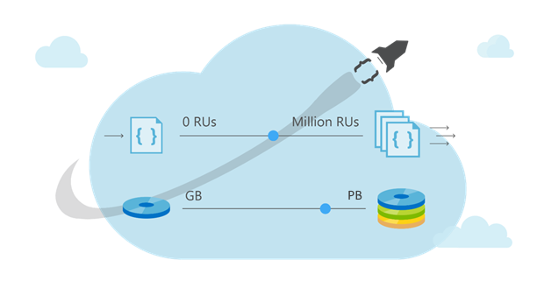
Partitioning
Leveraging Azure Cosmos DB to automatically scale your data across the globe
This module will reference partitioning in the context of all Azure Cosmos DB modules and APIs.

Slide 75
Partitioning- Why Do We Do It In The First Place?
As data size grows, instead of buying more machines (scaling up) we distribute our data across multiple machines
Each machine is responsible for serving subset of the data.
Analogy: Working in a team

Slide 76
Partitioning
Logical partition: Stores all data associated with the same partition key value
Physical partition: Fixed amount of reserved SSD-backed storage + compute.
Cosmos DB distributes logical partitions among a smaller number of physical partitions.
From user’s perspective: define 1 partition key per container

Slide 77
Partitions
Partitions
hash(City ID)
….
Beijing
Redmond
Seattle
Shanghai
Paris
Partition 1
Partition 2
Partition N
Range 1
Range 2
Range X

Slide 78
Partitions
Documents with same partition key value (City ID) are in same partition
hash(City ID)
Beijing
Shanghai
….
Beijing
Redmond
Seattle
Shanghai
Paris
Partition 1
Partition 2
Partition N
Range 1
Range 2
Range X

Slide 79
Partitions
hash(City ID)
Automatically split when close to full
….
Tianjin
Austin
…
Berlin
…
Beijing
Redmond
Tianjin
+
Seattle
Shanghai
Austin
Paris
Partition x2
Berlin
Partition x1
Partition 1
Partition 2
Partition N
Range X1
Range X2
Range 1
Range 2
Range X

Slide 80
RU’s divided among Partitions
10,000 RU/s provisioned for collection
Cosmos DB distributes RU/s evenly across physical partitions
hash(City ID)
2000 RU/s
2000 RU/s
2000 RU/s
….
Beijing
Redmond
Tianjin
Seattle
Shanghai
Austin
Paris
Berlin
Partition 1
Partition 2
Partition 5
Range 1
Range 2
Range 5

Slide 81
Partitions
Best Practices: Design Goals for Choosing a Good Partition Key
Distribute the overall request + storage volume
Avoid “hot” partition keys
Partition Key is scope for multi-record transactions and routing queries
Queries can be intelligently routed via partition key
Omitting partition key on query requires fan-out
Steps for Success
Ballpark scale needs (size/throughput)
Understand the workload
# of reads/sec vs writes per sec
Use pareto principal (80/20 rule) to help optimize bulk of workload
For reads – understand top 3-5 queries (look for common filters)
For writes – understand transactional needs
General Tips
Build a POC to strengthen your understanding of the workload and iterate (avoid analyses paralysis)
Don’t be afraid of having too many partition keys
Partitions keys are logical
More partition keys  more scalability

Slide 82
Partition Key Storage Limits
HTTP 403
Containers support unlimited storage by dynamically allocating additional physical partitions
Storage for single partition key value (logical partition) is quota'ed to 10GB.
When a partition key reaches its provisioned storage limit, requests to create new resources will return a HTTP Status Code of 403 (Forbidden).
Azure Cosmos DB will automatically add partitions, and may also return a 403 if:
An authorization token has expired
A programmatic element (UDF, Stored Procedure, Trigger) has been flagged for repeated violations
Notes:
The next could of slides have example strategies that take advantage of the 403 status code

Slide 83
Design Patterns for Large Partition Keys
"Linked List Approach" By Spreading Data Across Incremental Partition Key Values
For workloads that exceed quotas for a single partition key value, you can logically spread items across multiple partition keys within a container by using a suffix on the partition key value.
As a partition fills up, you can determine when to increment the partition key value by looking for the 403 status code in your application’s logic.
HTTP 403
HTTP 403
Notes:
You can endlessly increment partition key suffixes to work around any technical limitations for a specific partition (throughput and storage)

Slide 84
Design Patterns For Large Partition Keys
"Circular Buffer" Approach By Reusing Unique Ids
As you insert new items into a container’s partition, you can increment the unique id for each item in the partition.
When you get a 403 status code, indicating the partition is full, you can restart your unique id and upsert the items to replace older documents.
15
HTTP 403
ARD
15
2
3
4
5
6
7
8
9
10
11
12
13
14
Notes:
Using this example, you have effectively created a fixed-size collection of items that replaces the oldest items (determined by sorted unique key).

Slide 85
Hot/Cold Partitions
Partition Usage Can Vary Over Time
Partitions that are approaching thresholds are referred to as hot. Partitions that are underutilized are referred to as cold.
Abstract Storage or Throughput Threshold
Hot Partition
Partition
Partition
Cold Partition
Cold Partition

Slide 86
Query Fan-Out
Cross-partition Queries Can Be Performed Server-side Or Client-side
Cross-partition queries are opt-in
Cross-partition queries can be tuned and parallelized
Creates a bottleneck
Must wait for all partitions to return before the query is “done”

Slide 87
Cross-Partition SDK Example
IQueryable<DeviceReading> crossPartitionQuery = client.CreateDocumentQuery<DeviceReading>(
UriFactory.CreateDocumentCollectionUri("db", "coll"),
new FeedOptions {
EnableCrossPartitionQuery = true,
MaxDegreeOfParallelism = 10,
MaxBufferedItemCount = 100
})
.Where(m => m.MetricType == "Temperature" && m.MetricValue > 100)
.OrderBy(m => m.MetricValue);

Slide 88

Cross-Partition SDK Example
var querySpec = {
query: 'SELECT * FROM container c’
};
var feedOptions = {
enableCrossPartitionQuery = true
maxDegreeOfParallelism = 10
};
client.queryDocuments(collectionLink, querySpec, feedOptions)
.toArray(function (err, results) {
}

Slide 89

Cross-Partition SDK Example
FeedOptions options = new FeedOptions();
options.setEnableCrossPartitionQuery(true);
Iterator<Document> it = client.queryDocuments(
collectionLink,
"SELECT * from r",
options
).getQueryIterator();

Slide 90
Cross-Partition Query

Slide 91
Query Fan-Out
Querying Across Partitions Is Not Always A Bad Thing
If you have relevant data to return, creating a cross-partition query is a perfectly acceptable workload with a predictable throughput.
In an ideal situation, queries are filtered to only include relevant partitions.
Blind Query Fan-outs Can Add Up
You are charged ~1 RU for each partition that doesn’t have any relevant data.
Multiple fan-out queries can quickly max out RU/s for each partition

Slide 92

Query Fan-Out
Concurrency And Fan-out Queries
>10,000 fan-out queries in a second can leave all partitions hot
Example: Query on a vehicle database, partitioned by model name, where the query is filtering by year without filtering to only include relevant partitions.
All partitions are likely hot
10,000 queries per second checking this partition
10,000 queries per second checking this partition
SELECT * FROM car a WHERE a.year = “2015”
>10,000 more queries per second
10,000 queries per second checking this partition
PK = origin
SELECT * FROM car a WHERE a.year = “2016”
Example – Contoso Connected Car

Slide 93
Query Fan-Out
Concurrency And Fan-Out Queries
Filtering queries to only include relevant partition key values reduces the amount of wasted effort and focuses queries on those relevant partitions.
Only relevant queries checking this partition
Only relevant queries checking this partition
SELECT * FROM car a
WHERE a.model = “TURLIC” AND a.year = “2015”
>10,000 more queries per second
Only relevant queries checking this partition
PK = origin
SELECT * FROM car a
WHERE a.model = “COASH” AND a.year = “2016”
Example – Contoso Connected Car

Slide 94
Client-Side Query Fan-Out
Use Client-Side Threads and Parallelism to fan-out queries across partitions
Leverage existing client device power
Perform queries in parallel across units
Potentially process early-finish results before parallel requests are complete

Slide 95
Review: Choosing a partition Key
For each Cosmos DB container, you should specify a partition key.
It should satisfy the following core properties:
Evenly distribute requests
Evenly distribute storage
Have a high cardinality (each partition can grow up to 10 GB in size)
Notes:
Design Goals for Choosing a Good Partition Key
Distribute the overall request + storage volume
Avoid “hot” partition keys
Partition Key is scope for [efficient] queries and transactions
Queries can be intelligently routed via partition key
Omitting partition key on query requires fan-out
Steps for Success
Ballpark scale needs (size/throughput)
Understand the workload
# of reads/sec vs writes per sec
Use 80/20 rule to help optimize bulk of workload
For reads – understand top X queries (look for common filters)
For writes – understand transactional needs understand ratio of inserts vs updates
General Tips
Don’t be afraid of having too many partition keys
Partitions keys are logical
More partition keys => more scalability

Slide 96
Review: Choosing a partition Key
In addition, there are a few other areas to consider:
Queries can be intelligently routed via partition key:
Queries that are scoped to a single partition (or small set of partitions) will consume fewer RU’s than queries that must “fan-out” and check every partition
No partition key with query -> requires fan-out
Multi-document transactions must be within a single partition
Notes:
Design Goals for Choosing a Good Partition Key
Distribute the overall request + storage volume
Avoid “hot” partition keys
Partition Key is scope for [efficient] queries and transactions
Queries can be intelligently routed via partition key
Omitting partition key on query requires fan-out
Steps for Success
Ballpark scale needs (size/throughput)
Understand the workload
# of reads/sec vs writes per sec
Use 80/20 rule to help optimize bulk of workload
For reads – understand top X queries (look for common filters)
For writes – understand transactional needs understand ratio of inserts vs updates
General Tips
Don’t be afraid of having too many partition keys
Partitions keys are logical
More partition keys => more scalability

Slide 97

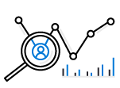


Partition Design
EXAMPLE SCENARIO
Contoso Connected Car is a vehicle telematics company. They are planning to store vehicle telemetry data from millions of vehicles every second in Azure Cosmos DB to power predictive maintenance, fleet management, and driver risk analysis.
WHAT ARE A FEW POTENTIAL PARTITION KEY CHOICES?
Vehicle Model
Current Time
Device Id
Composite Key – Device ID + Current Time
Example – Contoso Connected Car
Notes:
Design Goals for Choosing a Good Partition Key
Distribute the overall request + storage volume
Avoid “hot” partition keys
Partition Key is scope for [efficient] queries and transactions
Queries can be intelligently routed via partition key
Omitting partition key on query requires fan-out
Steps for Success
Ballpark scale needs (size/throughput)
Understand the workload
# of reads/sec vs writes per sec
Use 80/20 rule to help optimize bulk of workload
For reads – understand top X queries (look for common filters)
For writes – understand transactional needs understand ratio of inserts vs updates
General Tips
Don’t be afraid of having too many partition keys
Partitions keys are logical
More partition keys => more scalability

Slide 98
Partition Key Choices
VEHICLE MODEL (e.g. Model A)
Most auto manufactures only have a couple dozen models. This will create a fixed number of logical partition key values; and is potentially the least granular option.
Depending how uniform sales are across various models – this introduces possibilities for hot partition keys on both storage and throughput.
CURRENT MONTH (e.g. 2018-04)
Auto manufacturers have transactions occurring throughout the year. This will create a more balanced distribution of storage across partition key values.
However, most business transactions occur on recent data creating the possibility of a hot partition key for the current month on throughput.
Storage Distribution
Throughput Distribution
Storage Distribution
Throughput Distribution
Rodel
Rodel
2018-03
2018-03
Prisma
Prisma
2018-04
2018-04
Turlic
Turlic
2018-05
2018-05
Coash
Coash
2018-06
2018-06
Example – Contoso Connected Car

Slide 99
Partition Key Choices
DEVICE ID (e.g. Device123)
Each car would have a unique device ID. This creates a large number of partition key values and would have a significant amount of granularity.
Depending on how many transactions occur per vehicle, it is possible to a specific partition key that reaches the storage limit per partition key
COMPOSITE KEY (Device ID + Time)
This composite option increases the granularity of partition key values by combining the current month and a device ID. Specific partition key values have less of a risk of hitting storage limitations as they only relate to a single month of data for a specific vehicle.
Throughput in this example would be distributed more to logical partition key values for the current month.
Storage Distribution
Throughput Distribution
Storage Distribution
Throughput Distribution
C49E27EB
C49E27EB
C49E27EB-2018-05
C49E27EB-2018-05
FE53547A
FE53547A
C49E27EB-2018-06
C49E27EB-2018-06
E84906BE
E84906BE
4376B4BC-2018-05
4376B4BC-2018-05
4376B4BC
4376B4BC
4376B4BC-2018-06
4376B4BC-2018-06
Example – Contoso Connected Car
Notes:
Device ID is likely a good choice for this data. Obviously we did not take into account the workload’s queries so this could impact the choice as well. For example, if the workload had a lot of filters based on Vehicle Model, this could make it a better choice.

Slide 100
Partitioning FAQ
You mentioned that RU’s are divided among partitions. If I pick a partition key with a high cardinality, I might have thousands (or more) logical partitions. Does this mean each one will only get a small amount of RU’s?
No, RU’s are divided among physical partitions. As a developer using Cosmos DB, you should specify a logical partition key with a high cardinality so that each logical partition stays small in size (under the 10 GB limit). This is a recommended approach. It is likely that you will have many different logical partitions on the same physical partition. Cosmos DB handles all of this for you automatically ☺
I can’t find a partition key that satisfies all properties mentioned earlier. What should I do?
There are clear-tradeoffs between different partition key choices. One trick that sometimes helps is combining different fields to create a synthetic partition key (like we showed in the example earlier). In most cases, you will need to weigh tradeoffs between different possible choices.
Do cross-partition fan-out queries use the index?
Yes, indexing and partitioning are two completely separate concepts. Cross-partition queries are different from full scans. You can have a cross-partition query that still leverages indexing policy. You will be charged ~1 RU for every physical partition that you must read from (that doesn’t contain any results). For small data sizes, this extra cost is trivial. However, cross-partition queries should generally be avoided for frequent executed queries on large collections.
How can I manage physical partitions?
As a developer, you should only interact with and think about logical partitions (based on the partition key that you specify). Cosmos DB will manage all aspects of physical partitions automatically.

Slide 101
Query with SQL API

Slide 102
Querying
Tuning query techniques and parameters to make the most efficient use of a globally distributed database service.
This module will reference querying in the context of the SQL API for Azure Cosmos DB.

Slide 103
SQL Query Syntax
Basic Query Syntax
The SELECT & FROM keywords are the basic components of every query.
SELECT
tickets.id,
tickets.pricePaid
FROM tickets
SELECT
t.id,
t.pricePaid
FROM tickets t
Notes:
https://www.documentdb.com/sql/demo

Slide 104
SQL Query Syntax - Where
Filtering
WHERE supports complex scalar expressions including arithmetic, comparison and logical operators
SELECT
tickets.id,
tickets.pricePaid
FROM tickets
WHERE
tickets.pricePaid > 500.00 AND
tickets.pricePaid <= 1000.00
Notes:
https://www.documentdb.com/sql/demo

Slide 105
SQL Query Syntax - Projection
JSON Projection
If your workloads require a specific JSON schema, Azure Cosmos DB supports JSON projection within its queries
SELECT {
"id": tickets.id,
"flightNumber": tickets.assignedFlight.flightNumber,
"purchase": {
"cost": tickets.pricePaid
},
"stops": [
tickets.assignedFlight.origin,
tickets.assignedFlight.destination
]
} AS ticket
FROM tickets
[
{
"ticket": {
"id": "6ebe1165836a",
"purchase": {
"cost": 575.5
},
"stops": [
"SEA",
"JFK"
]
}
}
]
Notes:
https://www.documentdb.com/sql/demo

Slide 106
SQL Query Syntax - Projection
Select Value
The VALUE keyword can further flatten the result collection if needed for a specific application workload
SELECT {
"id": tickets.id,
"flightNumber": tickets.assignedFlight.flightNumber,
"purchase": {
"cost": tickets.pricePaid
},
"stops": [
tickets.assignedFlight.origin,
tickets.assignedFlight.destination
]
} AS ticket
FROM tickets
[
{
"ticket": {
"id": "6ebe1165836a",
"purchase": {
"cost": 575.5
},
"stops": [
"SEA",
"JFK"
]
}
}
]
Notes:
https://www.documentdb.com/sql/demo

Slide 107
Intra-Document Join
Azure Cosmos DB supports intra-document JOIN’s for de-normalized arrays
Let’s assume that we have two JSON documents in a collection:
{
"pricePaid": 575.5,
"assignedFlight": {
"number": "F125",
"origin": "SEA",
"destination": "JFK"
},
"seat": “12A",
"requests": [
"kosher_meal",
"aisle_seat"
],
"id": "6ebe1165836a"
}
{
"pricePaid": 234.75,
"assignedFlight": {
"number": "F752",
"origin": "SEA",
"destination": "LGA"
},
"seat": "14C",
"requests": [
"early_boarding",
"window_seat"
],
"id": "c4991b4d2efc"
}
We are interested in querying an array internal to the document
SQL

Slide 108
Intra-Document Join
We can filter on a particular array index position without JOIN:
[
{
"number":"F125","seat":"12A",
"requests": [
"kosher_meal",
"aisle_seat"
]
}
]
SELECT
tickets.assignedFlight.number,
tickets.seat,
ticket.requests
FROM
tickets
WHERE
ticket.requests[1] == "aisle_seat"
SQL

Slide 109
Intra-Document Join
JOIN allows us to merge embedded documents or arrays across multiple documents and returned a flattened result set:
[
{
"number":"F125","seat":"12A",
"requests":"kosher_meal"
},
{
"number":"F125","seat":"12A",
"requests":"aisle_seat"
},
{
"number":"F752","seat":"14C",
"requests":"early_boarding"
},
{
"number":"F752","seat":"14C",
"requests":"window_seat"
}
]
SELECT
tickets.assignedFlight.number,
tickets.seat,
requests
FROM
tickets
JOIN
requests IN tickets.requests
SQL

Slide 110
Intra-Document Join
Along with JOIN, we can also filter the cross products without knowing the array index position:
[
{
"number":"F125","seat":"12A“,
"requests": "aisle_seat"
},
{
"number":"F752","seat":"14C",
"requests": "window_seat"
}
]
SELECT
tickets.id, requests
FROM
tickets
JOIN
requests IN tickets.requests
WHERE
requests
IN ("aisle_seat", "window_seat")
SQL

Slide 111
Paginated Query Results
Straightforward approach to paginate the results:
var query = client.CreateDocumentQuery<ExampleEntity>(collectionUri, options);
var docQuery = query.AsDocumentQuery();
List<ExampleEntity> results = new List<ExampleEntity>();
while (docQuery.HasMoreResults)
{
foreach (ExampleEntity item in await query.ExecuteNextAsync())
{
results.Add(item);
}
}

Slide 112
Paginated Query Results
Pagination with ToList():
var query = client.CreateDocumentQuery<ExampleEntity>(collectionUri, options);
var docQuery = query.AsDocumentQuery();
List<ExampleEntity> results = new List<ExampleEntity>();
results = query.ToList();
ToList() automatically iterates through all pages

Slide 113
Paginated Query Results
Pagination with hasNext() in Java:
Iterator<Document> documents = client.queryDocuments(
collectionLink,
queryString,
options
).getQueryIterator();
while(documents.hasNext()) {
Document current = documents.next();
}

Slide 114
Sql Query Parametrization
var query = client.CreateDocumentQuery<ExampleEntity>(collectionUri,
new SqlQuerySpec
{
QueryText = "SELECT * FROM dataset s WHERE (s.id = @id)",
Parameters = new SqlParameterCollection
{
new SqlParameter("@id", “exampleIdentifier")
}
}, options
);
List<ExampleEntity> results = new List<ExampleEntity>();
results = query.ToList<ExampleEntity>();

Slide 115
SQL Query In Linq
var query = client.CreateDocumentQuery<ExampleEntity>(collectionUri, options);
var docQuery = query
.Where(s => s.LastName == "Andersen")
.Select(s => new { Name = s.LastName })
.AsDocumentQuery();
List<ExampleEntity> results = new List<ExampleEntity>();
results = query.ToList<ExampleEntity>();

Slide 116
Query Tuning
Some important Cosmos DB query performance factors include:
Provisioned throughput
Measure RU per query, and ensure that you have the required provisioned throughput for your queries
Partitioning and partition keys
Favor queries with the partition key value in the filter clause for low latency
SDK and query options
Follow SDK best practices like direct connectivity, and tune client-side query execution options
Network latency
Account for network overhead in measurement, and use multi-homing APIs to read from the nearest region

Slide 117
Query Tuning
Additional important Cosmos DB query performance factors include:
Indexing Policy
Ensure that you have the required indexing paths/policy for the query
Query Complexity
Use simple queries to enable greater scale.
Query execution metrics
Analyze the query execution metrics to identify potential rewrites of query and data shapes
Notes:
Query Complexity: avoid using complex queries (such as MongoDB aggregation pipeline) whenever simpler queries are possible (such as find/SELECT with filter condition). Simpler queries scale much better.

Slide 118
Client Query Parallelism
Cross-Partition queries can be parallelized to use as many threads as possible
Modern processors ship with both physical and virtual (hyper-threading) cores. For any given cross-partition query, the SDK can use concurrent threads to issue the query across the underlying partitions.
By default, the SDK uses a slow start algorithm for cross-partition queries, increasing the amount of threads over time. This increase is exponential up to any physical or network limitations.
Primary Thread
Concurrent Thread
DOP = 4
Concurrent Thread
Concurrent Thread
Query Thread
DOP = 1

Slide 119
Client Response Buffer
2
First Request
1
3
First Response
6
4
Concurrent Request
5
Client Buffer
Concurrent Response
Notes:
The client device’s code using an SDK to issue a request
The SDK issues the first request for query results to the Azure Cosmos DB service
The Azure Cosmos DB service returns the first set of results to be processed by the client (serialization, etc)
While the client is processing the first set of results, a concurrent request is sent to pre-fetch additional results
The items returned as a response of the current request are then stored in a client-side buffer
Buffered items are processed by the client SDK

Slide 120
SDK Query Options
These two options can be tuned through the sdk. While there are tradeoffs for each, it is important to understand that neither has any impact on total RU’s consumed
Decreased Thread Usage
Slower Performance
Increased Thread Usage
Faster Performance
0
Max Degree of Parallelism
∞
Smaller Memory Footprint
Slower Performance
Larger Memory Footprint
Faster Performance
0
Max Buffered Item Count
∞

Slide 121
SDK Query Options
Setting | Value | Effect
MaxDegreeofParallelism | -1 | The system will automatically decide the number of items to buffer
 | 0 | Do not add any additional concurrent threads
 | >= 1 | Add the specified number of additional concurrent threads
MaxBufferedItemCount | -1 | The system will automatically decide the number of concurrent operations to run
 | 0 | Do not maintain a client-side buffer
 | >= 1 | Specify the maximum size (items) of the client-side buffer

Slide 122
Review Of Request Units
Request Units (RUs) is a rate-based currency
Abstracts physical resources for performing requests
Key to multi-tenancy, SLAs, and COGS efficiency
Foreground and background activities
% Memory
% CPU
% IOPS

Slide 123
Measuring RU Charge
Analyze Query Complexity
The complexity of a query impacts how many Request Units are consumed for an operation. The number of predicates, nature of the predicates, number of system functions, and the number of index matches / query results all influence the cost of query operations.
Measure Query Cost
To measure the cost of any operation (create, update, or delete):
Inspect the x-ms-request-charge header
Inspect the RequestCharge property in ResourceResponse or FeedResponse in the SDK
Number Of Indexed Terms Impacts Write RU Charges
Every write operation will require the indexer to run. The more indexed terms you have, the more indexing will be directly having an effect on the RU charge.
You can optimize for this by fine-tuning your index policy to include only fields and/or paths certain to be used in queries.

Slide 124
Measuring RU Charge
Stabilized Logical Charges
Azure Cosmos DB uses information about past runs to produce a stable logical charge for the majority of CRUD or query operations.
Since this stable charge exists, we can rely on our operations having a high degree of predictability with very little variation. We can use the predictable RU charges for future capacity planning.
Bulk Of Query RU Charges is IO
Query RU is directly proportional to the quantity of query results.
Notes:
Azure Cosmos DB uses ML to produce a stable logical charge for vast majority of operations (CRUD and query). This gives a high degree of predictability for capacity planning (if creating document X costs 5 RU’s today, we can rely on the fact that it will cost 5 RU’s tomorrow). This isolates RU charge from variability in physical resource utilization due to other noisy processes like garbage collection

Slide 125
RU Charge Measurement Example
ResourceResponse<Document> response = await client.CreateDocumentAsync(
collectionLink,
document
);
var requestUnits = response.RequestCharge;

Slide 126
RU Charge Measurement Example
client.createDocument(
collectionLink,
documentDefinition,
function (err, document, headers) {
if (err) {
console.log(err);
}
var requestData = headers['x-ms-request-charge'];
}
);

Slide 127
RU Charge Measurement Example
ResourceResponse<Document> response = client.createDocument(
collectionLink,
documentDefinition,
null,
false
);
Double requestCharge = response.getRequestCharge();

Slide 128
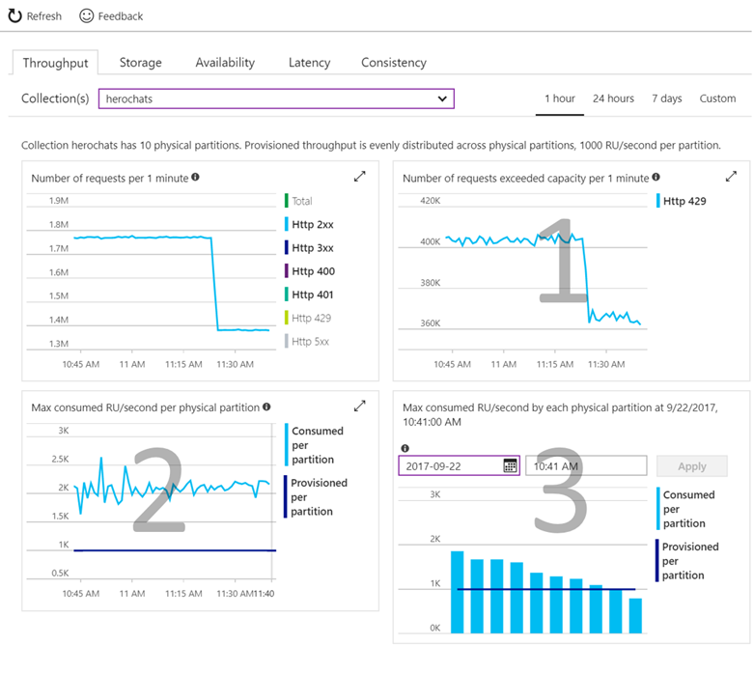
Validating Provisioned Throughput Choice
Check if your operations are getting rate limited.
Requests exceeding capacity chart
Check if consumed throughput exceeds the provisioned throughput on any of the physical partitions
Max RU/second consumed per partition chart
Select the time where the maximum consumed throughput per partition exceeded provisioned on the chart
Max consumed throughput by each partition chart
Notes:
Check if your operations are getting throttled.
Look at the "Requests exceeding capacity" chart on the throughput tab.
Check if consumed throughput exceeds the provisioned throughput on any of the physical partitions
Look at the "Max RU/second consumed per partition" metric.
Select the time where the maximum consumed throughput per partitions exceeded provisioned on the chart
Look at the "Max consumed throughput by each partition" chart

Slide 129
Cross-Partition Aggregate
Low-Latency Aggregations:
You can submit a simple SQL query and Azure Cosmos DB handles the routing of the query among data partitions and merges results to return the final aggregate values.
SELECT VALUE
COUNT(1)
FROM
telemetry t
WHERE
t.deviceId = "craft267_seat17"
Example – Contoso Connected Car
Notes:
Regardless of the size or number of partitions in your collection, you can submit a simple SQL query and Azure Cosmos DB handles the routing of the query among data partitions, runs it in parallel against the local indexes within each matched partition, and merges intermediate results to return the final aggregate values.

Slide 130
Bounded Location Search Using Geo-Data
{
"type":"Point",
"coordinates":[ 31.9, -4.8 ]
}
{
"type":"Polygon",
"coordinates":[[
[ 31.8, -5 ],
[ 31.8, -4.7 ],
[ 32, -4.7 ],
[ 32, -5 ],
[ 31.8, -5 ]
]]
}
GEOJSON SPECIFICATION
Azure Cosmos DB supports indexing and querying of geospatial point data that's represented using the GeoJSON specification.
SEARCH BY DISTANCE FROM POINT
The ST_DISTANCE built-in function returns the distance between the two GeoJSON Point expressions.
SEARCH WITHOUT BOUNDED POLYGON
The ST_WITHIN built-in function returns a Boolean indicating whether the first GeoJSON Point expression is within a GeoJSON Polygon expression.
Notes:
GeoJSON data structures are always valid JSON objects, so they can be stored and queried using Azure Cosmos DB without any specialized tools or libraries. The Azure Cosmos DB SDKs provide helper classes and methods that make it easy to work with spatial data.
Both the ST_DISTANCE and ST_WITHIN functions can be used with Polygons and LineStrings in addition to Points.
f you include spatial indexing in your indexing policy, then "distance queries" will be served efficiently through the index. For more details on spatial indexing, see the section below. If you don't have a spatial index for the specified paths, you can still perform spatial queries by specifying x-ms-documentdb-query-enable-scan request header (or FeedOptions.EnableScanInQuery using the SDK) with the value set to "true".

Slide 131
Distance From Center Point Search
SELECT *
FROM flights f
WHERE ST_DISTANCE(f.origin.location, {
"type": "Point",
"coordinates": [-122.19, 47.36]
}) < 100 * 1000
ST_DISTANCE
ST_DISTANCE can be used to measure the distance between two points. Commonly this function is used to determine if a point is within a specified range (meters) of another point.

Slide 132
Polygon Shape Search
SELECT *
FROM flights f
WHERE ST_WITHIN(f.destination.location, {
"type": "Polygon",
"coordinates": [[
[-124.63, 48.36],
[-123.87, 46.14],
[-122.23, 45.54],
[-119.17, 45.95],
[-116.92, 45.96],
[-116.99, 49.00],
[-123.05, 49.02],
[-123.15, 48.31],
[-124.63, 48.36]
]]
})
ST_WITHIN
ST_WITHIN can be used to check if a point lies within a Polygon. Commonly Polygons are used to represent boundaries like zip codes, state boundaries, or natural formations.
Polygon arguments in ST_WITHIN can contain only a single ring, that is, the Polygons must not contain holes in them.
Notes:
Again if you include spatial indexing in your indexing policy, then "within" queries will be served efficiently through the index.

Slide 133
Server-Side Programming

Slide 134
Programming
Run native JavaScript server-side programming logic to performic atomic multi-record transactions.
This module will reference programming in the context of the SQL API.
GEEK

Slide 135

Stored Procedures
Benefits
Familiar programming language
Atomic Transactions
Built-in Optimizations
Business Logic Encapsulation
Notes:
The fact that JSON is intrinsically mapped to the Javascript language type system and is also the basic unit of storage in Cosmos DB allows for a number of optimizations like lazy materialization of JSON documents in the buffer pool and making them available on-demand to the executing code.
Azure Cosmos DB precompiles stored procedures, triggers and user defined functions (UDFs) to avoid JavaScript compilation cost for each invocation. The overhead of building the byte code for the procedural logic is amortized to a minimal value.

Slide 136
Simple Stored Procedure
function createSampleDocument(documentToCreate) {
var context = getContext();
var collection = context.getCollection();
var accepted = collection.createDocument(
collection.getSelfLink(),
documentToCreate,
function (error, documentCreated) {
context.getResponse().setBody(documentCreated.id)
}
);
if (!accepted) return;
}
Notes:
This stored procedure takes as input documentToCreate, the body of a document to be created in the current collection. All such operations are asynchronous and depend on JavaScript function callbacks. The callback function has two parameters, one for the error object in case the operation fails, and one for the created object. Inside the callback, users can either handle the exception or throw an error. In case a callback is not provided and there is an error, the Azure Cosmos DB runtime throws an error.
In the example above, the callback throws an error if the operation failed. Otherwise, it sets the id of the created document as the body of the response to the client. Here is how this stored procedure is executed with input parameters.

Slide 137
Multi-Document Transactions
Database Transactions
In a typical database, a transaction can be defined as a sequence of operations performed as a single logical unit of work. Each transaction provides ACID guarantees.
In Azure Cosmos DB, JavaScript is hosted in the same memory space as the database. Hence, requests made within stored procedures and triggers execute in the same scope of a database session.
Stored procedures utilize snapshot isolation to guarantee all reads within the transaction will see a consistent snapshot of the data
Create New Document
Query Collection
Update Existing Document
Delete Existing Document
Notes:
ACID
Atomicity guarantees that all the work done inside a transaction is treated as a single unit where either all of it is committed or none.
Consistency makes sure that the data is always in a good internal state across transactions.
Isolation guarantees that no two transactions interfere with each other – generally, most commercial systems provide multiple isolation levels that can be used based on the application needs.
Durability ensures that any change that’s committed in the database will always be present.
Since requests made within stored procedures and triggers execute in the same scope of a database session, we guarantee ACID for all operations that are part of a single stored procedure/trigger. Consider the following stored procedure definition.

Slide 138
Bounded Execution
Execution Within Time Boundaries
All Azure Cosmos DB operations must complete within the server-specified request timeout duration. If an operation does not complete within that time limit, the transaction is rolled back.
Helper Boolean Value
All functions under the collection object (for create, read, replace, and delete of documents and attachments) return a Boolean value that represents whether that operation will complete:
If true, the operation is expected to complete
If false, the time limit will soon be reached and your function should end execution as soon as possible.
Notes:
The request timeout constraint also applies to JavaScript functions (stored procedures, triggers and user-defined functions).
If the boolean value is false, it is an indication that the time limit is about to expire and that the procedure must wrap up execution.
Operations queued prior to the first unaccepted store operation are guaranteed to complete if the stored procedure completes in time and does not queue any more requests.

Slide 139
Transaction Continuation Model
CONTINUING LONG-RUNNING TRANSACTIONS
JavaScript functions can implement a continuation-based model to batch/resume execution
The continuation value can be any value of your own choosing. This value can then be used by your applications to resume a transaction from a new “starting point”
Bulk Create Documents
Each Document
Try Create
Observe
Return
Value
Done
Return a “pointer” to resume later

Slide 140
CONTROL FLOW
Javascript Control Flow
Stored procedures allow you to naturally express control flow, variable scoping, assignment, and integration of exception handling primitives with database transactions directly in terms of the JavaScript programming language.
ES6 Promises
ES6 promises can be used to implement promises for Azure Cosmos DB stored procedures. Unfortunately, promises “swallow” exceptions by default. It is recommended to use callbacks instead of ES6 promises.
Notes:
http://es6-features.org/#PromiseUsage

Slide 141
Stored Procedure Control Flow
function createTwoDocuments(docA, docB) {
var ctxt = getContext(); var coll = context.getCollection(); var collLink = coll.getSelfLink();
var aAccepted = coll.createDocument(collLink, docA, docACallback);
function docACallback(error, created) {
var bAccepted = coll.createDocument(collLink, docB, docBCallback);
if (!bAccepted) return;
};
function docBCallback(error, created) {
context.getResponse().setBody({
"firstDocId": created.id,
"secondDocId": created.id
});
};
}
Notes:
The focus here is on identifying nested callbacks.

Slide 142
Stored Procedure Control Flow
function createTwoDocuments(docA, docB) {
var ctxt = getContext(); var coll = context.getCollection(); var collLink = coll.getSelfLink();
var aAccepted = coll.createDocument(collLink, docA, function(docAError, docACreated) {
var bAccepted = coll.createDocument(collLink, docB, function(docBError, docBCreated) {
context.getResponse().setBody({
"firstDocId": docACreated.id,
"secondDocId": docBCreated.id
});
});
if (!aAccepted) return;
});
if (!bAccepted) return;
}
Nesting your callbacks is just as valid of a method as using named callback functions
Notes:
The focus here is on identifying nested callbacks.

Slide 143
Rolling Back Transactions
Transaction Roll-Back
Inside a JavaScript function, all operations are automatically wrapped under a single transaction:
If the function completes without any exception, all data changes are committed
If there is any exception that’s thrown from the script, Azure Cosmos DB’s JavaScript runtime will roll back the whole transaction.
Implicit BEGIN TRANSACTION
Implicit COMMIT TRANSACTION
Create New Document
Query Collection
Update Existing Document
Delete Existing Document
Implicit ROLLBACK TRANSACTION
Transaction Scope
If exception, undo changes
Notes:
Transactions are deeply and natively integrated into Cosmos DB’s JavaScript programming model.
In effect, the “BEGIN TRANSACTION” and “COMMIT TRANSACTION” statements in relational databases are implicit in Cosmos DB.
Throwing an exception is effectively equivalent to a “ROLLBACK TRANSACTION” in Cosmos DB.

Slide 144
Transaction Rollback in Stored Procedure
collection.createDocument(
collection.getSelfLink(),
documentToCreate,
function (error, documentCreated) {
if (error) throw "Unable to create document, aborting...";
}
);
collection.createDocument(
documentToReplace._self,
replacementDocument,
function (error, documentReplaced) {
if (error) throw "Unable to update document, aborting...";
}
);

Slide 145
Debugging Stored Procedures
CONSOLE LOGGING
Much like with traditional JavaScript applications, you can use console.log() to capture various telemetry and data points for your running code.
VIEWING SCRIPT LOGS
.NET
You must opt-in to viewing and capturing console output using the EnableScriptLogging boolean property available in the client SDK. The SDK has a ScriptLog property on the StoredProcedureResponse class that contains the captured output of the JavaScript console log.

Slide 146
Debugging Stored Procedures
var response = await client.ExecuteStoredProcedureAsync(
document.SelfLink,
new RequestOptions
{
EnableScriptLogging = true
}
);
String logData = response.ScriptLog;

Slide 147
Debugging Stored Procedures
RequestOptions requestOptions = new RequestOptions();
requestOptions.EnableScriptLogging = true;
StoredProcedureResponse response = client.executeStoredProcedure(
storedProcLink,
requestOptions,
new Object[]{}
);

Slide 148
Authoring Stored Procedures

Slide 149
User-Defined Functions
UDF
User-defined functions (UDFs) are used to extend the Azure Cosmos DB SQL API’s query language grammar and implement custom business logic. UDFs can only be called from inside queries
They do not have access to the context object and are meant to be used as compute-only code
Notes:
UDFs can be run on secondary replicas of the Cosmos DB service.

Slide 150
User-Defined Function Definition
var taxUdf = {
id: "tax",
serverScript: function tax(income) {
if (income == undefined)
throw 'no input’;
if (income < 1000)
return income * 0.1;
else if (income < 10000)
return income * 0.2;
else
return income * 0.4;
}
}

Slide 151
User-Defined Function Usage In Queries
SELECT
*
FROM
TaxPayers t
WHERE
udf.tax(t.income) > 20000
SQL

Slide 152
Authoring User-Defined Functions

Slide 153
Concurrency

Slide 154
Write Optimized Database Engine
Optimistic Concurrency
The SQL API supports optimistic concurrency control (OCC) through HTTP entity tags, or ETags
Every SQL API resource has an ETag system property, and the ETag value is generated on the server every time a document is updated.
If the ETag value stays constant – that means no other process has updated the document. If the ETag value unexpectedly mutates – then another concurrent process has updated the document.
ETags can be used with the If-Match HTTP request header to allow the server to decide whether a resource should be updated:
If-Match
ETag Match
Check ETag
HTTP 412
ETag Stale
Notes:
If the ETag value matches the server ETag value, the resource is updated.
If the ETag is no longer current, the server rejects the operation with an "HTTP 412 Precondition failure" response code.
The client then re-fetches the resource to acquire the current ETag value for the resource.
In addition, ETags can be used with the If-None-Match header to determine whether a re-fetch of a resource is needed.

Slide 155
Control Concurrency Using Etags
Optimistic Concurrency
The SQL API supports optimistic concurrency control (OCC) through HTTP entity tags, or ETags
Every SQL API resource has an ETag system property, and the ETag value is generated on the server every time a document is updated.
If the ETag value stays constant – that means no other process has updated the document. If the ETag value unexpectedly mutates – then another concurrent process has updated the document.
ETags can be used with the If-Match HTTP request header to allow the server to decide whether a resource should be updated:
If-Match
ETag Match
Check ETag
HTTP 412
ETag Stale
Notes:
If the ETag value matches the server ETag value, the resource is updated.
If the ETag is no longer current, the server rejects the operation with an "HTTP 412 Precondition failure" response code.
The client then re-fetches the resource to acquire the current ETag value for the resource.
In addition, ETags can be used with the If-None-Match header to determine whether a re-fetch of a resource is needed.

Slide 156
Sample Document
{
"id": "2c9cddbb-a011-4947-94c2-6f8ccf421d2e",
"_rid": "o8ExAJlS4xRIAAAAAAAAAA==",
"_self": "dbs/o8ExAA==/colls/o8ExAJlS4xQ=/docs/o8ExAJlS4xRIAAAAAAAAAA==/",
"_etag": "\"2e004542-0000-0000-0000-5af31e8c0000\"",
"_attachments": "attachments/",
"_ts": 1525882508
}

Slide 157
Control Concurrency Using Etags
try
{
var ac = new AccessCondition { Condition = readDoc.ETag, Type = AccessConditionType.IfMatch };
updatedDoc = await client.ReplaceDocumentAsync(readDoc, new RequestOptions { AccessCondition = ac });
}
catch (DocumentClientException dce)
{
if (dce.StatusCode == HttpStatusCode.PreconditionFailed)
{
Console.WriteLine("Another concurrent process has updated the record");
}
}

Slide 158
Global Distribution

Slide 159
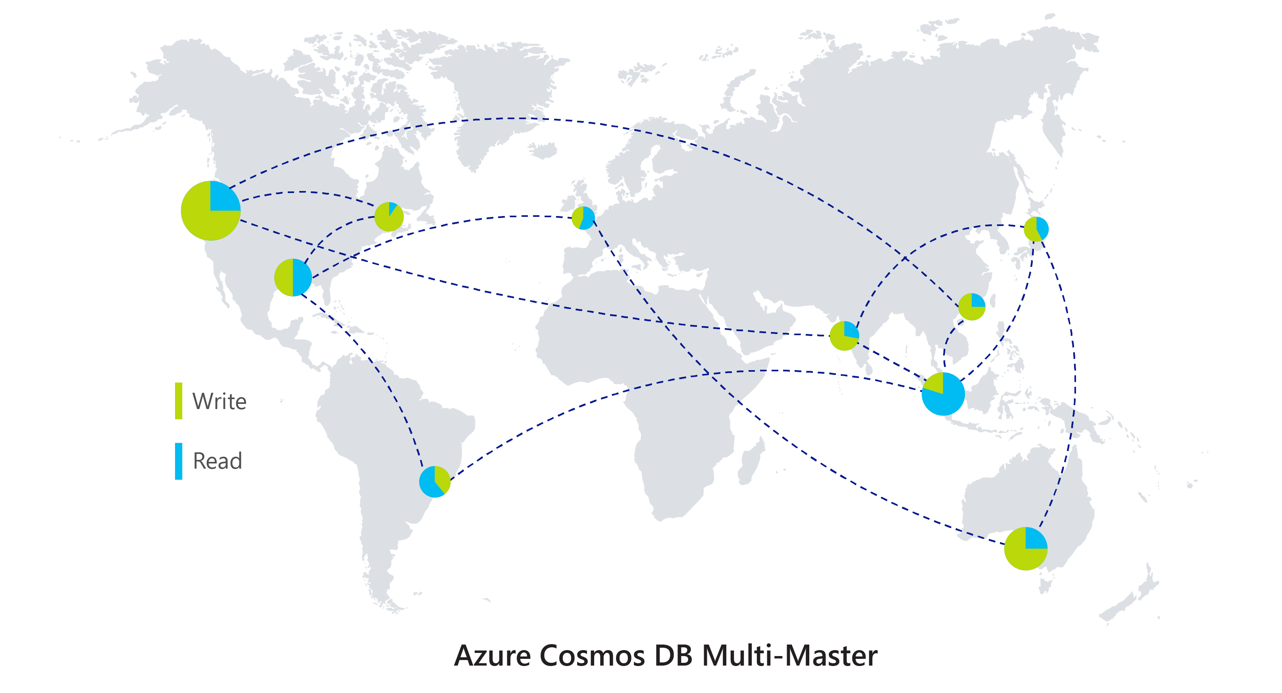
Multi-Master – Read/Write in any region
Benefits
Write scalability around the world
Low latency (<10ms P99 for 1kb document) writes around the world
99.999% High Availability around the world
Well-defined consistency models
Automatic conflict management

Slide 160
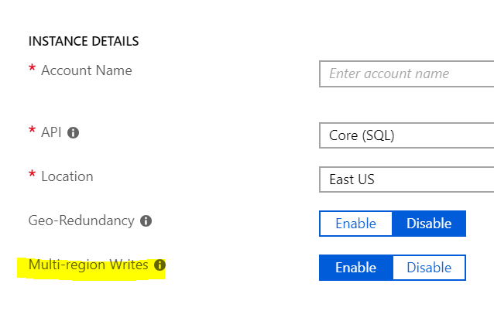
How to use it
Enable multi-master upon account creation

Slide 161
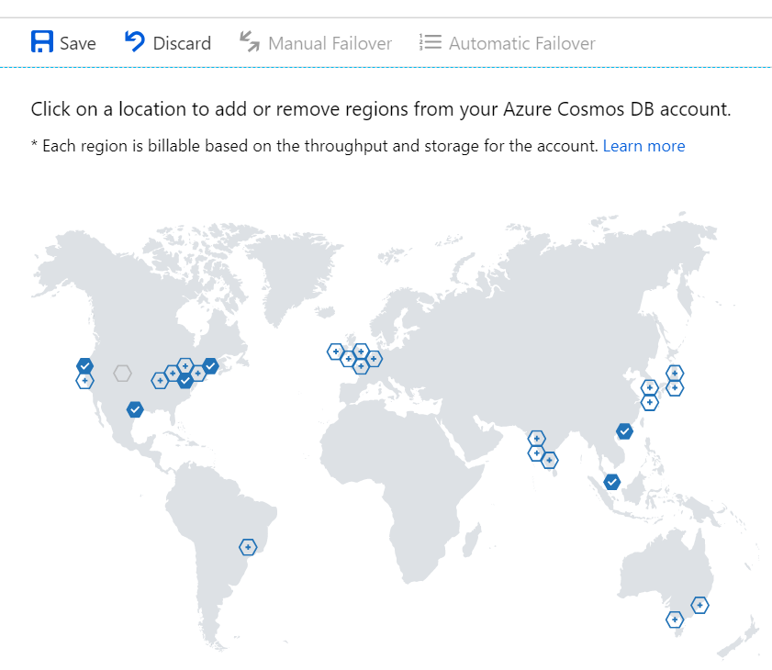
How to use it
Add desired regions via Portal

Slide 162
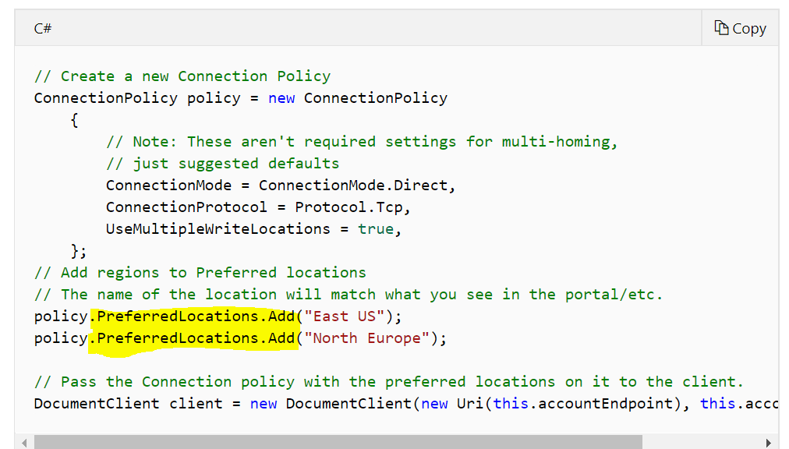
How to use it
Add preferred regions in SDK

Slide 163
What happens if region goes down?
Account type | Region goes down | What happens?
Single-master | Write | Customer needs to enable automatic failover Read region will be promoted to write region
 | Read | SDK routes to next preferred region, or write region if none set
Multi-master | Write | SDK routes to next preferred region
 | Read

Slide 164
Consistency
In a distributed system, where data is being replicated across regions, what version of data do readers see?
Latest version?
Old version?
Answer: Depends on consistency level

Slide 165
ACID != CAP
Consistency w.r.t. Transactions is NOT the same thing as Consistency w.r.t. Replication.
this is about moving from one valid state to another for a single given transaction
this about getting a consistent view across replicated copies of data

Slide 166
CAP Theorem
Brewer’s CAP Theorem: impossible for distributed data store to simultaneously provide more than 2 out of the following 3 guarantees:
Consistency, Availability, Partition Tolerance (in the face of network failures)
In reality, we need to ensure partition tolerance, so tradeoff is between consistency and availability

Slide 167
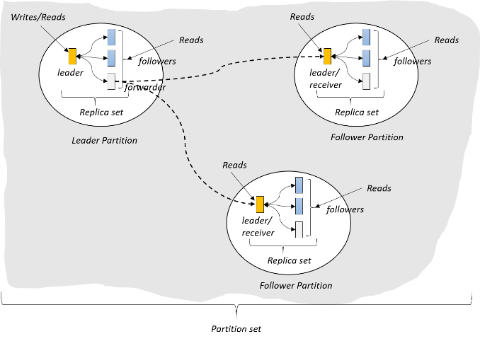
3 different regions
(West US)
(East US)
A
C
B
(North Europe)

Slide 168
3 different regions – value of record = 5
Value = 5
Value = 5
A
C
B
Value = 5

Slide 169
3 different regions – Value updated to 6 in Region A
Value = 5 6
Update 5 => 6
Value = 5
A
C
B
Value = 5

Slide 170
3 different regions – Network failure between A and B
Value = 5 6
Update 5 => 6
Value = 5 6
A
C
B
Value = 5
What happens when a network partition is introduced?

Slide 171
What should Region B see?
See 5: (prioritize availability)
Go offline until network is back: (prioritize consistency
Value = 5 6
Update 5 => 6
Value = 5 6
A
C
B
Value = 5
What happens when a network partition is introduced?
Region B does a read

Slide 172
CAP Theorem
Brewer’s CAP Theorem: impossible for distributed data store to simultaneously provide more than 2 out of the following 3 guarantees:
Consistency, Availability, Partition Tolerance (in the face of network failures)
In reality, we need to ensure partition tolerance, so tradeoff is between consistency and availability

Slide 173
What about in a normally functioning system?
PACELC Theorem: In the case of network partitioning (P) in a distributed computer system, one has to choose between availability (A) and consistency (C) (CAP Theorem)
but else (E), even when the system is running normally in the absence of network failures, one has to choose between latency (L) and consistency (C).

Slide 174
Region A updates 5->6, replicates to region C
Value = 5 6
Update 5 => 6
Value = 5 6
A
C
B
Value = 5
Latency: packet of information can travel as fast as speed of light.
Replication between distant geographic regions can take 100’s of milliseconds

Slide 175
Region A updates 5->6, replicates to region C. What value does B see?
Reader C: What is the value?
Value = 5 6
Update 5 => 6
Value = 5 6
A
C
B
Value = 5
Reader B: What is the value?

Slide 176
See 5 immediately: (prioritize latency)
Wait for 6 to propagate: (prioritize consistency
What value does B see?
Reader A: What is the value?
Value = 5 6
Update 5 => 6
Value = 5 6
Value = 5

Slide 177
What about in a normally functioning system?
PACELC Theorem: In the case of network partitioning (P) in a distributed computer system, one has to choose between availability (A) and consistency (C) (CAP Theorem)
but else (E), even when the system is running normally in the absence of network failures, one has to choose between latency (L) and consistency (C).

Slide 178

Programmable Data Consistency
Choice for most distributed apps
Strong consistency High latency
Eventual consistency, Low latency

Slide 179
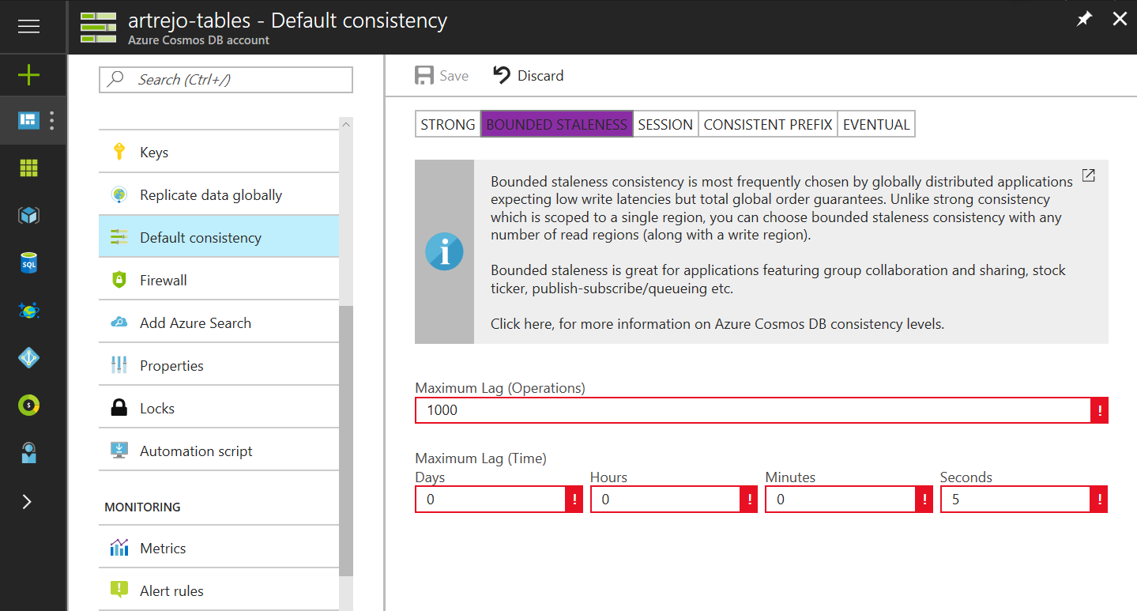

Well-Defined Consistency Models
Well-Defined Consistency Models
Intuitive programming model
5 Well-defined, consistency models
Overridable on a per-request basis
Clear tradeoffs
Latency
Availability
Throughput

Slide 180
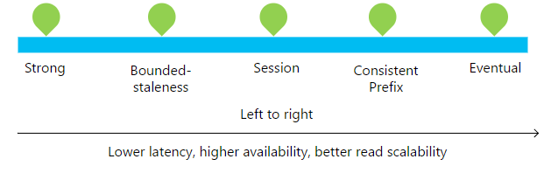
Well-Defined Consistency Models
Well-Defined Consistency Models

Slide 181
Well-Defined Consistency Models
Well-Defined Consistency Models
Consistency Level | Guarantees
Strong | Linearizability (once operation is complete, it will be visible to all)
Bounded Staleness | Consistent Prefix. Reads lag behind writes by at most k prefixes or t interval Similar properties to strong consistency (except within staleness window), while preserving 99.99% availability and low latency.
Session | Consistent Prefix. Within a session: monotonic reads, monotonic writes, read-your-writes, write-follows-reads Predictable consistency for a session, high read throughput + low latency
Consistent Prefix | Reads will never see out of order writes (no gaps).
Eventual | Potential for out of order reads. Lowest cost for reads of all consistency levels.

Slide 182
Bounded-Staleness
Bounds set server-side via the Azure Portal - Reads lag behind writes are by at most k prefixes or t interval

Slide 183
Session Consistency
Session is controlled using a “session token”. – Read your own writes within a session
Session tokens are automatically cached by the Client SDK
Can be pulled out and used to override other requests (to preserve session between multiple clients)
string sessionToken;
using (DocumentClient client = new DocumentClient(new Uri(""), ""))
{
ResourceResponse<Document> response = client.CreateDocumentAsync(
collectionLink,
new { id = "an id", value = "some value" }
).Result;
sessionToken = response.SessionToken;
}
using (DocumentClient client = new DocumentClient(new Uri(""), ""))
{
ResourceResponse<Document> read = client.ReadDocumentAsync(
documentLink,
new RequestOptions { SessionToken = sessionToken }
).Result;
}

Slide 184
Bounded-Staleness
Bounds set server-side via the Azure Portal - Reads lag behind writes are by at most k prefixes or t interval

Slide 185
Relaxing Consistency
Consistency can be relaxed on a per-request basis
client.ReadDocumentAsync(
documentLink,
new RequestOptions { ConsistencyLevel = ConsistencyLevel.Eventual }
);

Slide 186
Music notes visualization

Slide 187
Change Feed

Slide 188
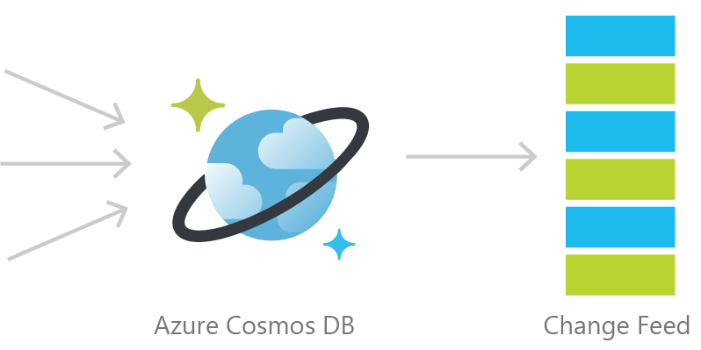
Cosmos DB Change Feed
Persistent log of documents within an Azure Cosmos DB collection in the order in which they were modified

Slide 189
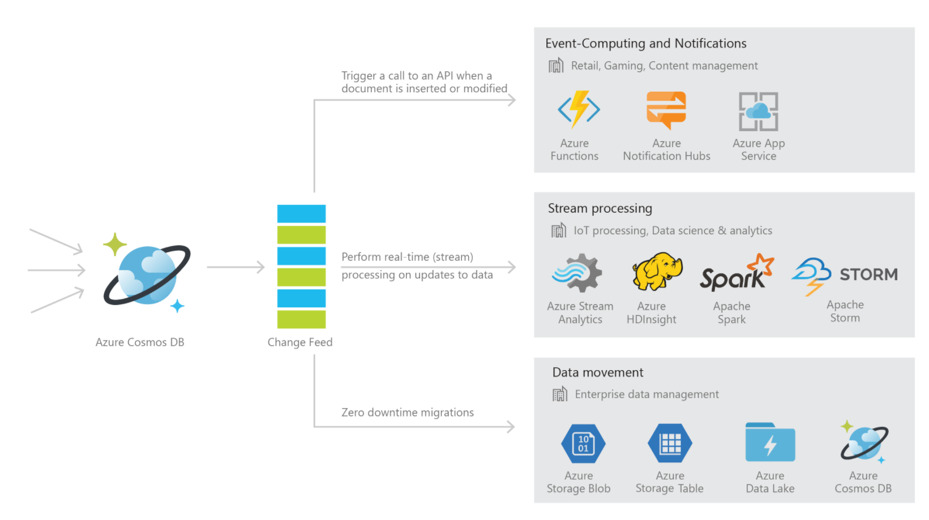

Slide 190


Common Scenarios
Event Sourcing (Microservices)
Read From Change Feed
Persistent Event Store
Microservice
#1
Microservice #2
New Order
Microservice #3
Trigger Action From Change Feed

Slide 191



Retail Order Processing Pipelines
Azure Functions
(E-Commerce Checkout API)
Azure Cosmos DB (Order Event Store)
. . .
Azure Functions
(Microservice 1: Tax)
Azure Functions
(Microservice 2: Payment)
Azure Functions
(Microservice N: Fulfillment)

Slide 192
Common Scenarios
Backup Collection
Data Movement / Backup
Access upon main collection failure
Replicate Updates
Main Collection
Secondary Collections
CRUD Data
Read access, e.g. for analytics
…

Slide 193
Common Scenarios
3 Materialized View
Application
Cosmos DB
Materialized View
SubscriptionID | UserID | Create Date | …
123abc | Ben6 | 6/17/17
456efg | Ben6 | 3/14/17
789hij | Jen4 | 8/1/16
012klm | Joe3 | 3/4/17
UserID | Total Subscriptions
Ben6 | 2
Jen4 | 1
Joe3 | 1

Slide 194
3 Different ways to use the Change Feed
Implementation | Use Case | Advantages
Azure Functions | Serverless applications | Easy to implement. Used as a trigger, input or output binding to an Azure Function.
Change Feed Processor Library | Distributed applications | Ability to distribute the processing of events towards multiple clients. Requires a “leases collection”.
SQL API SDK for .NET or Java | Not recommended | Requires manual implementation in a .NET or Java application.

Slide 195
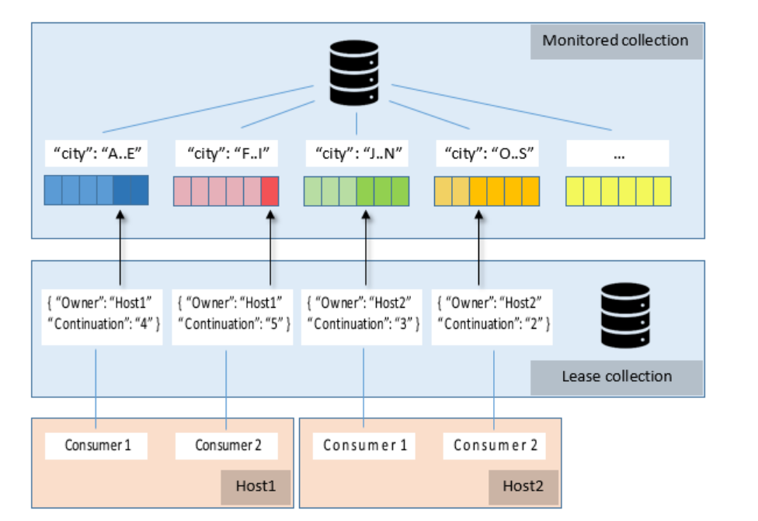
Using the Change Feed Processor Library
Spin up instances of the processor as needed
Each host has consumers = observer to implement
Each host assigns itself leases on partitions to monitor
On each change, logic in consumers gets triggered
1 lease collection stored in Cosmos DB

Slide 196
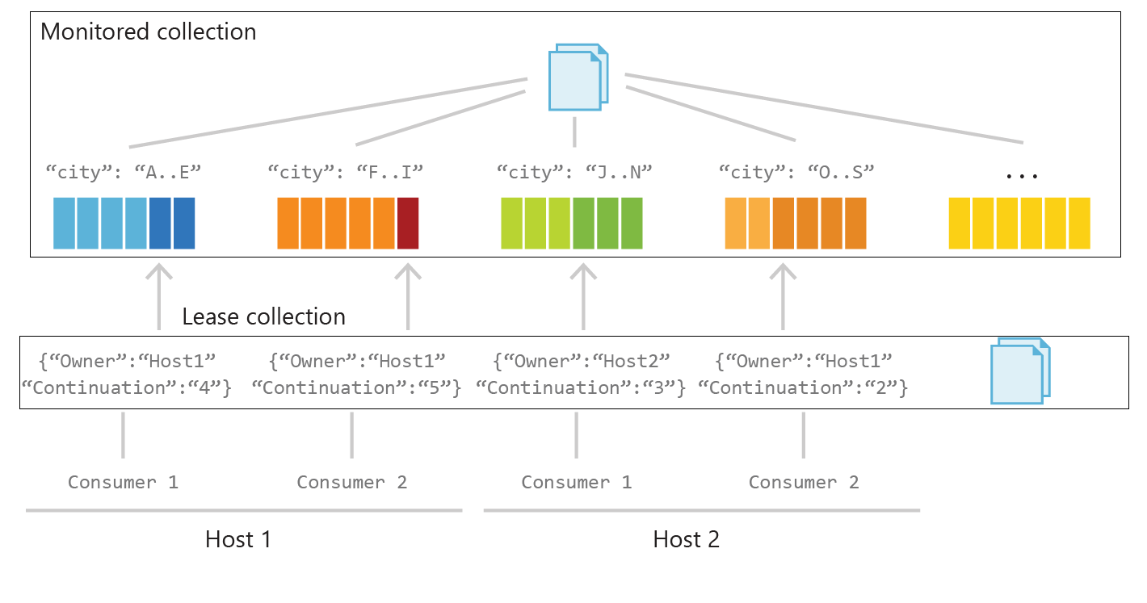

Slide 197
Change Feed Processor – Interface Implementation
public class DocumentFeedObserver : IChangeFeedObserver
{
...
public Task IChangeFeedObserver.ProcessChangesAsync(ChangeFeedObserverContext context, IReadOnlyList<Document> docs)
{
Console.WriteLine("Change feed: {0} documents", Interlocked.Add(ref totalDocs, docs.Count));
foreach(Document doc in docs)
{
Console.WriteLine(doc.Id.ToString());
}
return Task.CompletedTask;
}
}

Slide 198
Change Feed Processor - Registration
DocumentFeedObserver docObserver = new DocumentFeedObserver();
ChangeFeedEventHost host = new ChangeFeedEventHost(
hostName,
documentCollectionLocation,
leaseCollectionLocation,
feedOptions,
feedHostOptions
);
await host.RegisterObserverAsync(docObserverFactory);

Slide 199
Azure Cosmos DB Change Feed FAQ
Automatically enabled in any Cosmos DB database account.
Uses the existing allocated request units for processing events
Executed on insert and update operations. Delete support can be implemented with a flag.

Slide 200
Troubleshooting

Slide 201
Troubleshooting
Using HTTP/REST response status codes and headers to diagnose and troubleshoot requests.
This module will reference troubleshooting in the context of all Azure Cosmos DB modules and APIs.

Slide 202
Analyzing HTTP Responses
Response Status Codes
When a request is unsuccessful, Azure Cosmos DB responds using well-defined HTTP status codes that can provide more detail into exactly why a specific request failed.
Response Headers
Azure Cosmos DB uses a variety of HTTP headers to offer insight into the result of requests, error conditions, and useful metadata to perform actions such as:
Resume request
Measure RU/s charge associated with request
Access newly created resource directly.
HTTP response codes
2xx | Success
4xx | Client Errors
5xx | Server Errors

Slide 203
Errors- Exceptions handling
SQL API
* Retry all < 400 errors
* For mutation(Write/update) - ensure idempotency is taken care of – example 449
* For 503 error or Transport error(socket closed/channel is closed/service unavailable) – please have a loop of retry with exponential back-off and random jitter.
* if inserting/updating data in constraint of time (say from azure function/stream job – ensure you have dead letter queue or retry queue)
* Create alerts in Azure Monitor to get faster notification
Other API
* Use Native error handling

Slide 204
Monitoring
Client
Capture activity id, request charge, exception (error code/substatus code/stacktrace), query exec stats if any every operation. You can also record response size/request size just in case
When logged into APIM like AppInsight – you can quickly raise alerts and look at issues
Use Azure Monitor to track response/error codes/ RU provisoned and raising alerts
Use Diagnostic log for immutable log of control plane, data plane and query log for SQL API

Slide 205
Response Status Codes
Code | Meaning
200 OK | GET, PUT or POST operation was successful
201 Created | Resource created successfully using a POST operation
204 No Content | Resource deleted successfully using a DELETE operation
401 Unauthorized | Invalid Authorization header
403 Forbidden | Authorization token expired Resource quota reached when attempting to create a document Stored Procedure, Trigger or UDF is blacklisted from executed
409 Request Timeout | Stored Procedure, Trigger or UDF exceeded maximum execution time

Slide 206
Response Status Codes
Header | Value
409 Conflict | The item Id for a PUT or POST operation conflicts with an existing item
412 Precondition Failure | The specified eTag is different from the version on the server (optimistic concurrency error)
413 Entity Too Large | The item size exceeds maximum allowable document size of 2MB
429 Too Many Requests | Container has exceeded provisioned throughput limit
449 Retry With | Transient error has occurred, safe to retry
50x | Server-side error. If effort persists, contact support

Slide 207
Response Headers
Header | Value
x-ms-activity-id | Unique identifier for the operation
x-ms-serviceversion | Service Version used for request/response
x-ms-schemaversion | Schema Version used for request/response
x-ms-item-count | In a query (or read-feed), the number of items returned
x-ms-alt-content-path | REST URI to access resource using user-supplied IDs
etag | The same value as the _etag property of the requested item

Slide 208
Response Headers
Header | Value
x-ms-continuation | Token returned if a query (or read-feed) has more results and is resubmitted by clients as a request header to resume execution
x-ms-session-token | Used to maintain session consistency. Clients much echo this as a request header in subsequent operations to the same container
x-ms-request-charge | Number of normalized RU/s for the operation
x-ms-resource-quota | Allotted quota for the specified resource in the account
x-ms-resource-usage | Current usage count of the specified resource in the account
x-ms-retry-after-ms | If rate limited, the number of milliseconds to wait before retrying the operation
Notes:
Per Andrew, need to include “intro the standard HTTP response code convention of 2xx is success, 4xx is client error, 5xx is server error.”

Slide 209
Viewing REST API Response Metadata

Slide 210
Identifying Rate Limiting
HTTP Response Status Code
A rate limited request will return a HTTP status code of 429 (Too Many Requests). This response indicates that the container has exceeded provisioned throughput limit.
HTTP Response HEader
A rate limited request will also have a x-ms-retry-after-ms header. This header gives the number of milliseconds your application should wait before retrying the current request.
Automatic Retry On Throttle
The SDK automatically retries any throttled requests. This can potentially create a long-running client-side method that is attempting to retry throttled requests.
Notes:
https://httpstatuses.com/429

Slide 211
Logging
What Is Logged By Azure Diagnostic Logs:
All Authenticated Backend Requests Across All Protocols and API’s
Includes Failed Requests
Database Operations
Includes CRUD Operations On All Resources
Account Key Operations
Unauthenticated Requests
Requests That Result In A 401 Response

Slide 212
Viewing Logs in Log Analytics
Enable Logging
Diagnostic Logs for Azure Services are opt-in. You should first enable logging (using the Portal, CLI or PowerShell).
Logs take, on average, about two hours to be made available.
Log Analytics
If you selected the Send to Log Analytics option when you turned on diagnostic logging, diagnostic data from your collection is forwarded to Log Analytics.
From within the Log Analytics portal experience, you can:
Search logs using the expanded Log Analytics query language
Visualize the results of a query as a graph
Pin a graph visualization of a query to your Azure portal dashboard

Slide 213
Viewing Logs in Log Analytics

Slide 214
Hands-On Exercise Troubleshooting Failed and RATE LIMITED Requests
Tasks:
Simulate a Usage Spike in Requests
View Response Metadata
Third exercise task

